Slide 1
Age Related Expectation at the end of each academic year.
Early
Years

Slide 2
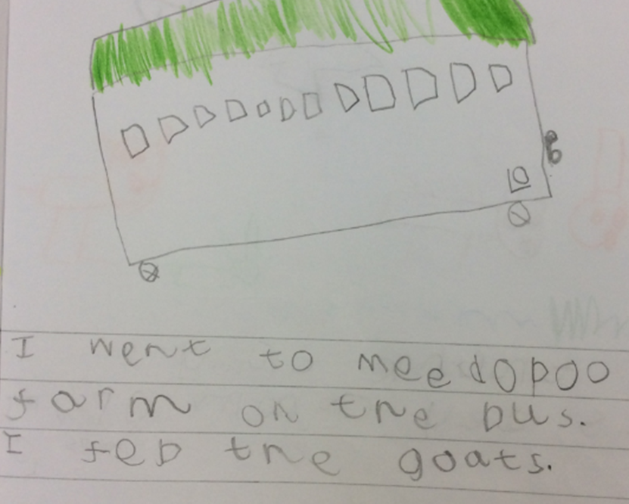
EYFS
End of Year “At Expectation”
(Early Learning Goal for Writing)

Slide 3
Age Related Expectation at the end of each academic year.

Slide 4
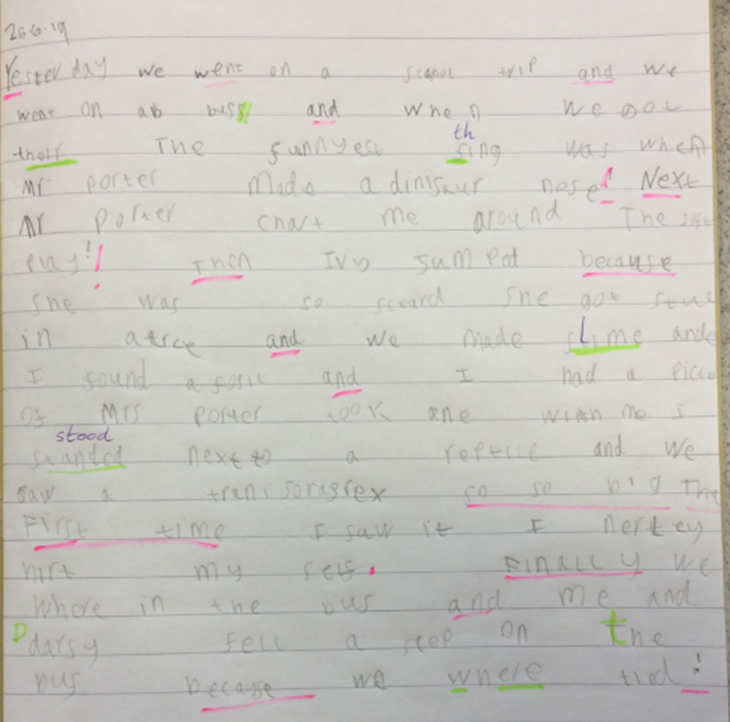
Y1
End of Year “At Expectation”

Slide 5
Age Related Expectation at the end of each academic year.
Two

Slide 6
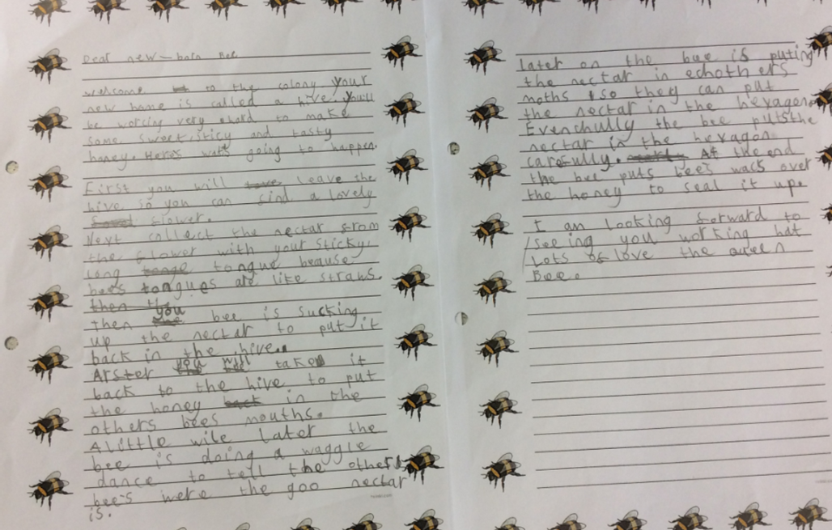
Y2
End of Year “At Expectation”

Slide 7
Age Related Expectation at the end of each academic year.
Three

Slide 8
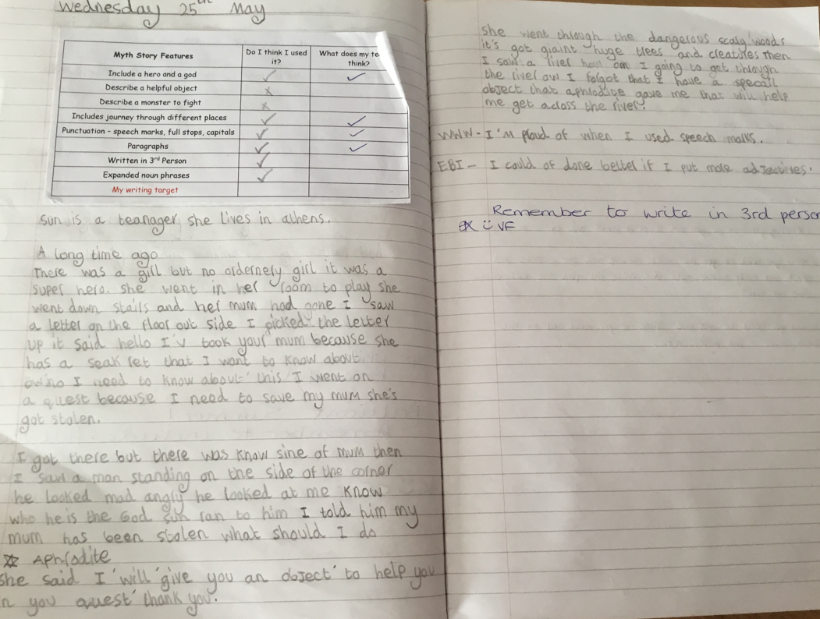
Y3
End of Year “At Expectation”

Slide 9
Age Related Expectation at the end of each academic year.
Four

Slide 10
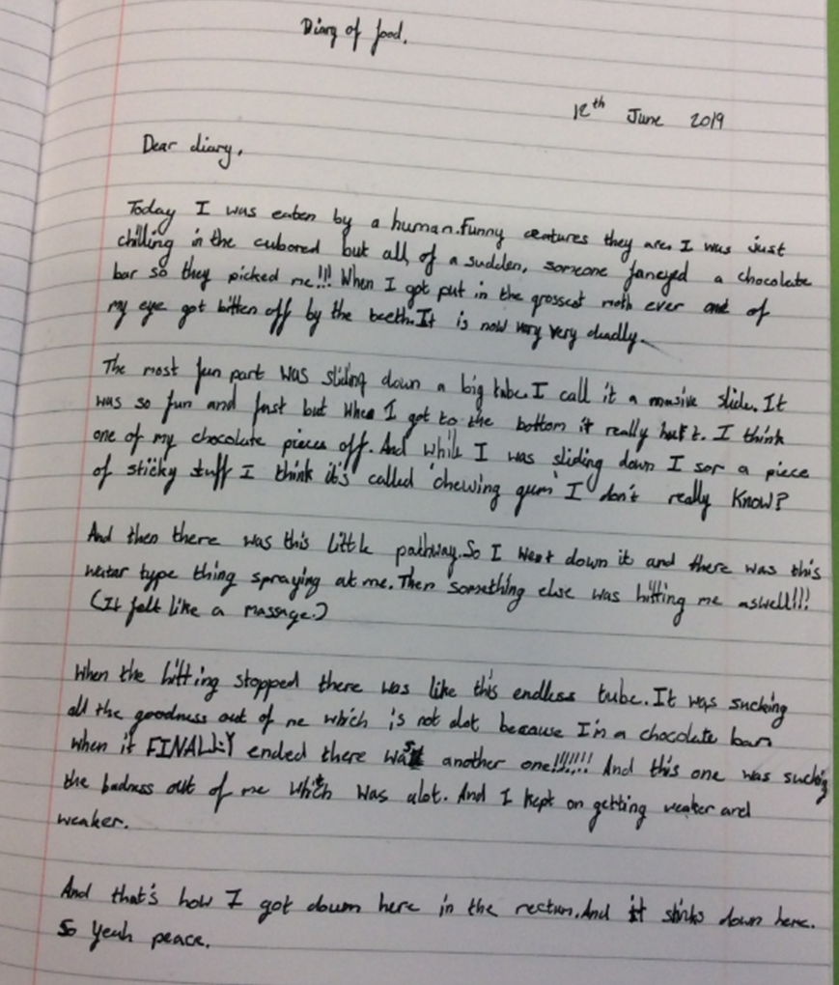
Year 4
End of Year “At Expectation”

