Slide 1


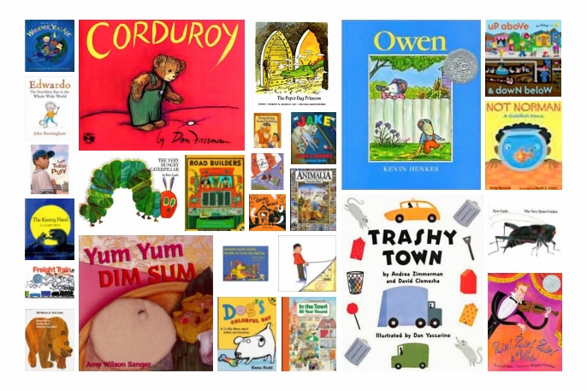
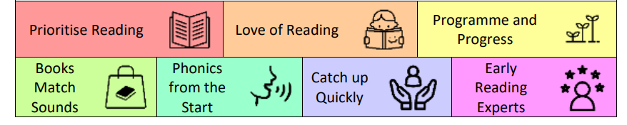
Reading
At Marston Moreteyne VC School
Our Top Priorities

Slide 2
1. Prioritise Reading
The school is determined that every pupil will learn to read, regardless of their background, needs or abilities.
All pupils, including the weakest readers, make sufficient progress to meet or exceed age-related expectations.

Slide 3

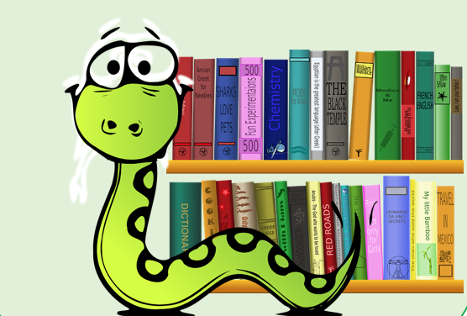
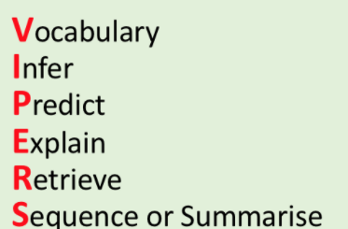

1. Prioritise Reading
Whole Class Guided Reading-Focussing on skills -Using VIPERS (Vocabulary, Inference, Punctuation, Explanation, Retrieval, Sequence/Summarise), including pre-teaching for lower attaining children
Daily Story sessions
Cross-Curricular Links to reading in all lessons
Regularly changed individual reading books and targeted daily readers including peer and paired reading
Accelerated Reader Quizzes used to assess and monitor comprehension/Skills and time spent on reading
Regular STAR assessment (or Early Literacy) to monitor progress
Identified interventions to support children not making progress (including support with a specialist Reading Teacher)

Slide 4
2. Love of Reading
Staff foster a love of reading
Stories, poems, rhymes and non-fiction are chosen for reading to develop pupils’ vocabulary, language comprehension and love of reading. Pupils are familiar with and enjoy listening to a wide range of stories, poems, rhymes and non-fiction.

Slide 5

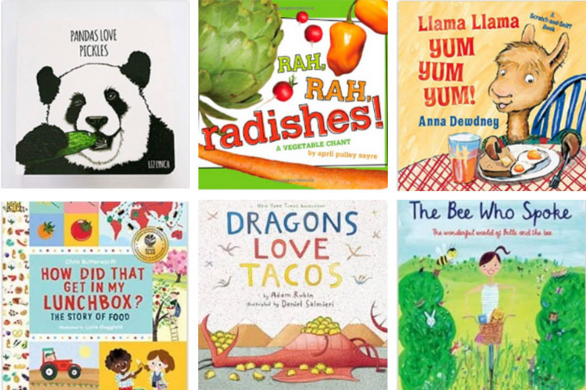

2. Love of Reading
Exciting and stimulating texts are chosen for Whole Class Guided Reading (including stories, poems, rhymes and non-fiction texts)
Adventurous vocabulary is taught discreetly as well as in all other lessons across the curriculum
Daily story sessions in place in all year groups
Children can talk about their favourite books and poems
A good selection of books for children to read are stocked in school library as well as classrooms
Paired Reading in place
A Celebration in school of World Book Day
Regular Book Fairs in school
Accelerated Reader achievements celebrated in assembly

Slide 6
3. Programme and Progress
The school’s phonics programme matches or exceeds the expectations of the English national curriculum and the early learning goals. The school has clear expectations of pupils’ phonics progress term-by-term, from Reception to Year 2.

Slide 7

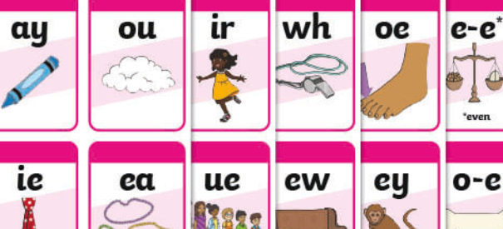
3. Programme and Progress
Clear structured Phonics lessons from EYFS to Year Two
Exciting and motivating lessons and activities in place
Jolly Phonics taught and embedded into KS1, as well as KS2 where necessary-fidelity in place through the school
Regular assessment and tracking in place to ensure knowledge is solid and is being applied independently
Children in EYFS are not held back if they are high attaining readers
Key Stage Two phonic interventions in place to re-visit and re-enforce skills and knowledge not yet learnt
Parents informed of how phonics is taught in school

Slide 8
4. Books Match Sounds
The sequence of reading books shows a cumulative progression in phonics knowledge that is matched closely to the school’s phonic programme. Teachers give pupils sufficient practice in reading and rereading books that match the grapheme-phoneme correspondences they know, both at school and at home.

Slide 9
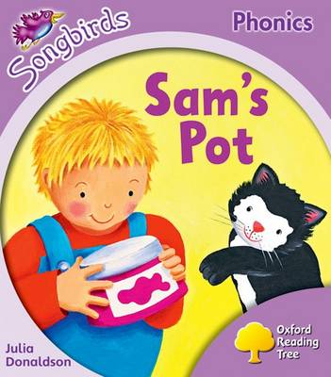

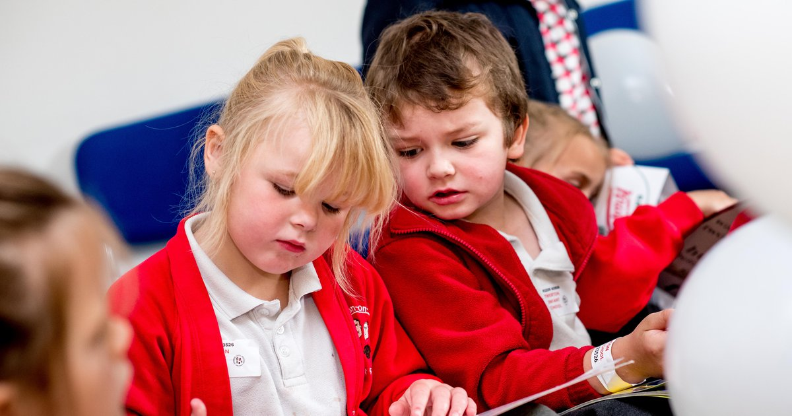
4. Books Match Sounds
In EYFS and Key Stage One books are banded and linked to the Jolly phonics content progression document
Children are sent home with phonic reading books and these are shared again in school with practitioners
Children have access to a selection of phonic based books to practice their skills independently
Parents are informed as to how we teach Phonics and how best they can support children at home
Whole class teaching of reading incorporates the children’s developing phonic knowledge alongside a love of books and vocabulary development

Slide 10
5. Children are taught Phonics from the Start Of Reception
Reading, including the teaching of systematic, synthetic phonics, is taught from the beginning of Reception.

Slide 11
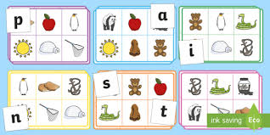
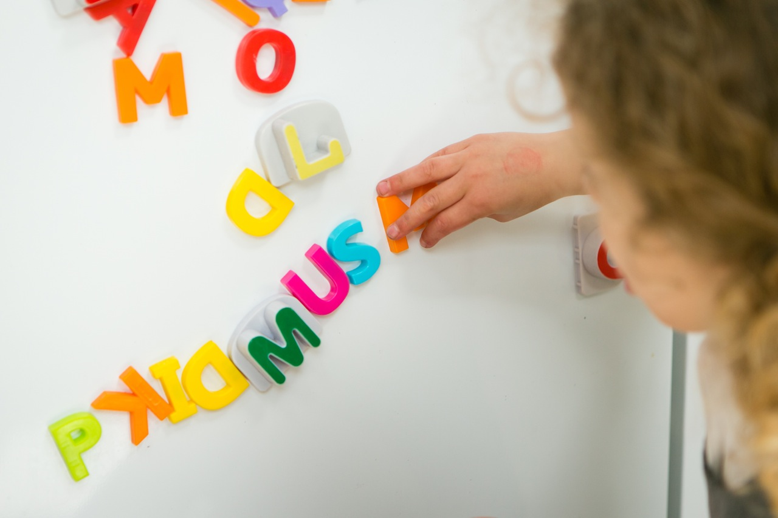
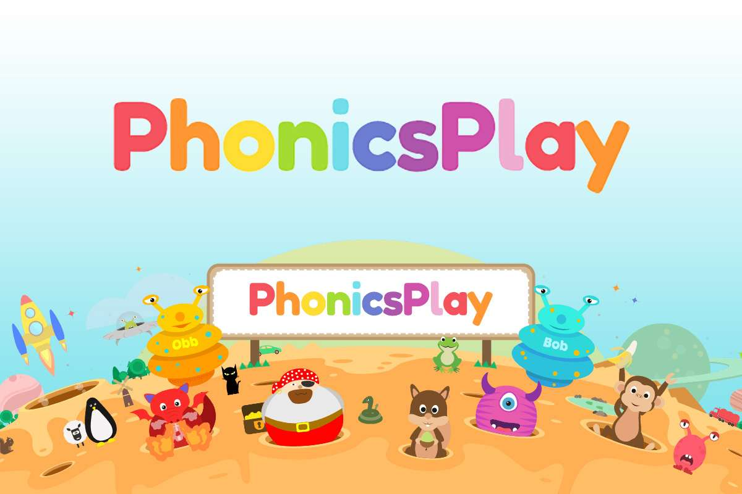
5. Children are taught Phonics from the Start Of Reception
Our EYFS Lead works with our Pre-School to ensure that early phonics is taught before the Reception school year. This includes the children experiencing a wealth of listening activities including songs, stories and rhymes. They will learn how to distinguish between speech and sounds and will begin to blend and segment words orally. They will begin to recognise spoken words that rhyme and explore rhyming words.
Very early phonics skills are repeated in Acorns for children needing more re-enforcement.
Recognition of graphemes, along with phonic knowledge starts in reception and carries on until all phonic content is covered through year one.
Interactive Phonic programs are use and ICT is incorporated
In continuous provision, both inside and out there is access to phonic stimulus and activity

Slide 12
6. Catch Up Quickly
The ongoing assessment of pupils’ phonics progress is sufficiently frequent and detailed to identify any pupil who is falling behind the programme’s pace, and targeted support is given immediately.

Slide 13
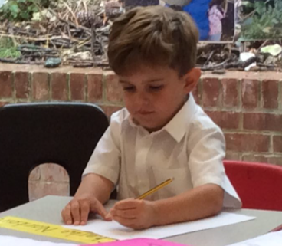
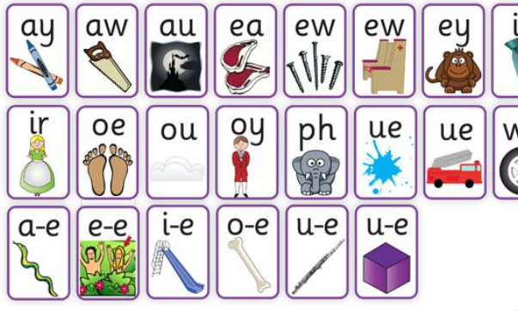

6. Catch Up Quickly
Ongoing assessment of phonics knowledge is in place in Key Stage One and Key Stage 2 where appropriate
Reading stages are monitored carefully and children are moved on at the appropriate time
Gaps in knowledge are assessed and targeted intervention is put in place to support children
Specialised Reading Teacher in school to work with targeted individuals and groups
Children's writing is carefully assessed with a clear focus on the application of their phonic knowledge and understanding of digraphs, trigraphs and alternative ways of spelling the same sound
Accelerated Reader data analysed in detail and used as a tool to spot children needing support

Slide 14
7. Staff are experts in early reading
The school has developed sufficient expertise in the teaching of phonics and reading

Slide 15
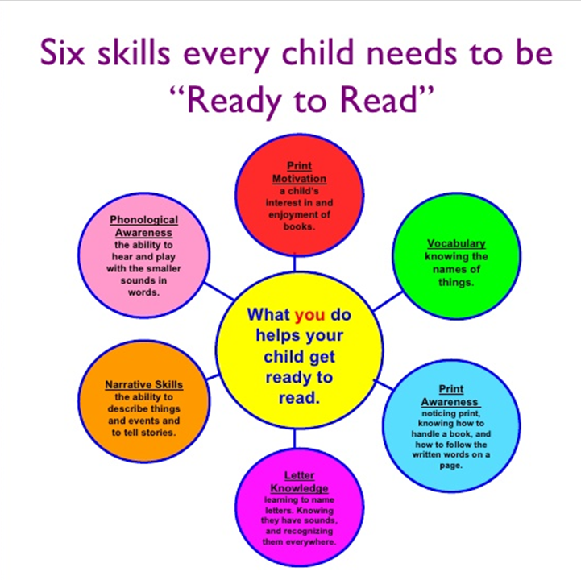
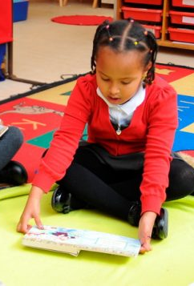
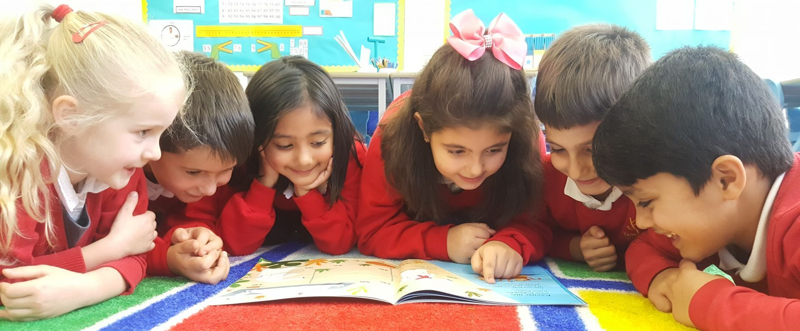
7. Staff are experts in early reading
Specialised Reading Teacher in school to work with teachers and support staff to ensure knowledge of practitioners is secure
Regular training in place
The teaching of Reading is monitored through the year as part of the yearly monitoring cycle
Reading lessons (as well as reading within the wider curriculum) are observed by Reading Lead and SLT
Excellent reading behaviours are modelled by all staff in school every day
Accelerated Reader data analysed in detail and used as a tool to identify children needing support

