Slide 1

Moving into Key Stage One
Reading is one of the first
things that children learn when they start school.
It is the foundation of all education. When children can read, other subjects then become available to them and independent learning can begin.

Slide 2
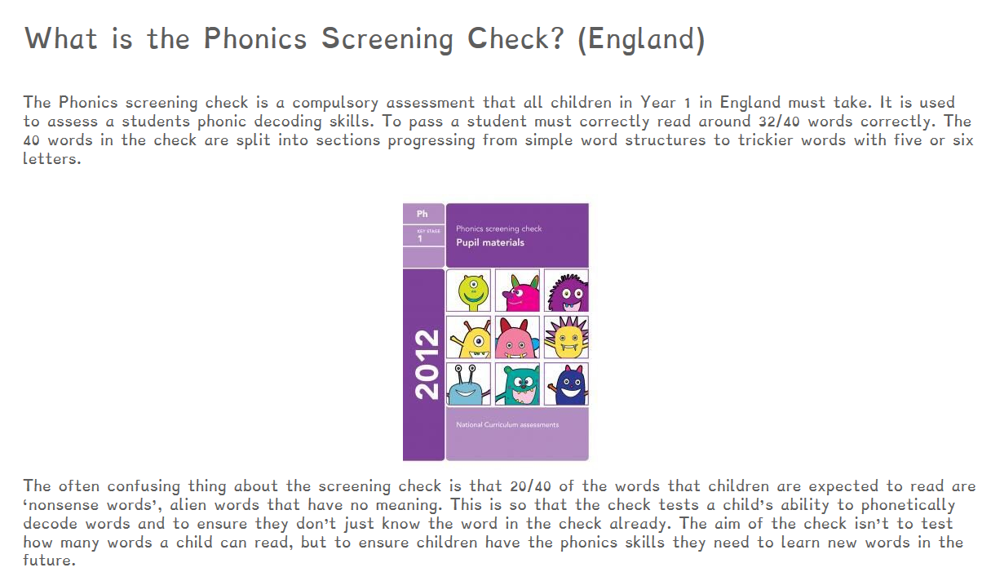

Slide 3
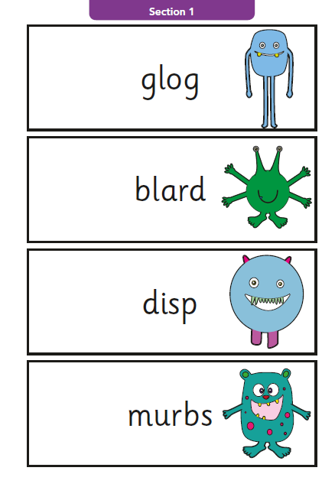
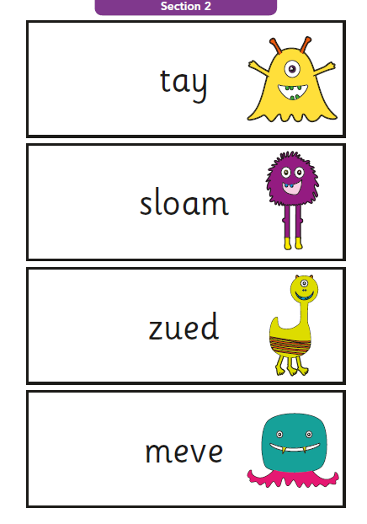

Slide 4
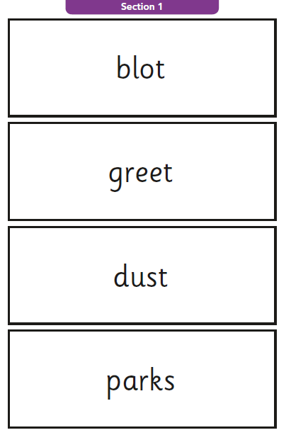
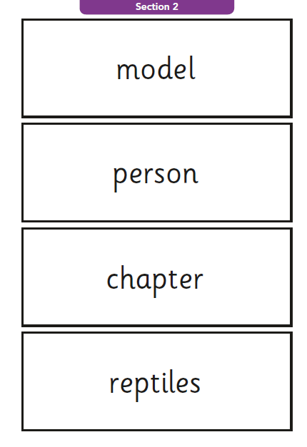

Slide 5
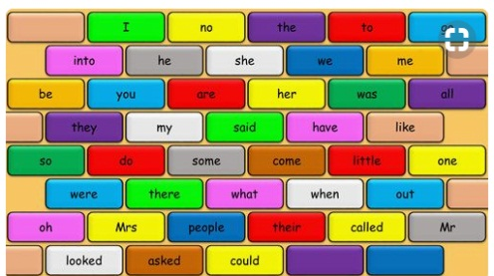
High Frequency “sight words”
Why learn to read words on sight?
Researcher shows that learning just 13 of the most frequently used words will enable children to read 25% of any text.
Learning 100 high frequency words gives a beginner reader access to 50% of virtually any text, whether a children's book or a newspaper report.
When you couple sight recognition of common and tricky words with knowledge of phonics, that's when a child's reading can really take off…

Slide 6
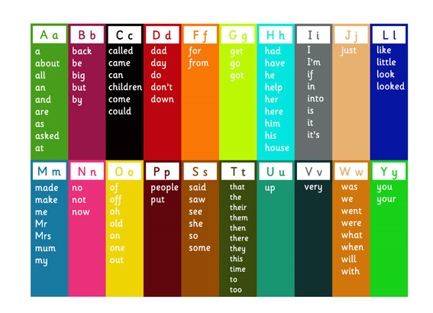

Slide 7



Understanding what you are reading, how can we ensure this happens?
Teaching children to be a
“Reading Detective” and look for clues in the text.

Slide 8
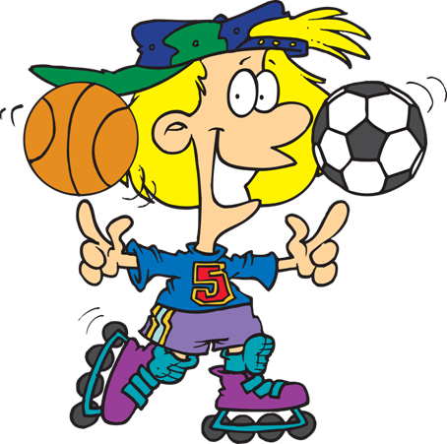
“Reading is an action sport”
Keene and Zimmerman
Reading is an action sport. The action takes place in our minds.
When we read its not enough to read the words correctly. (decode)
As we read the words, the meaning does not automatically jump into our heads!!
We have to read the words and build meaning, a bit like constructing a model.

Slide 9

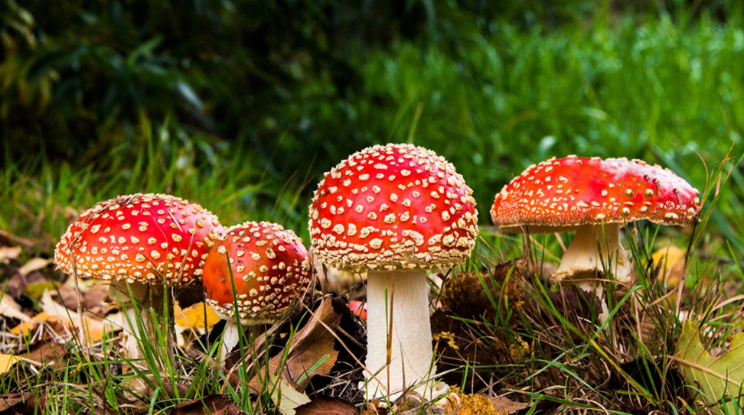



Who? When? Why? How? Where?
I wonder…

Slide 10



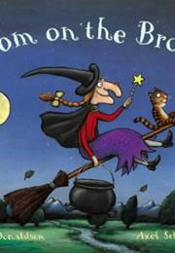



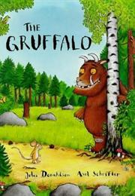
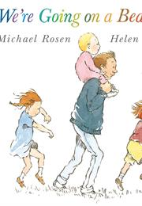


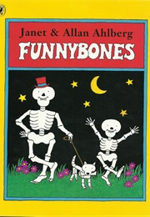

Slide 11


Slide 12
Authors do not spell out every detail as it would result in a long and boring text….
Jane was invited to Billy’s party. She wondered if he would like a kite. She shook her piggy bank. It made no sound. Jane was sad.

Slide 13
Jane was invited to Billy’s party. She wondered if he would like a kite. She shook her piggy bank. It made no sound. Jane was sad.
She needed a present to take
It must be his birthday
She was checking to see if she had any money
She wouldn’t be able to go to the party.
Oh dear that means there is no money inside
It must be his birthday

Slide 14

Before reading the book
Key Stage One
Look at all of the pictures and talk, talk, talk about everything you can see!
Can you point to the title? or
What is this? (pointing to the
title)
What do you think this story
will be about?
What do we call the writing
on the back of the book?
(Blurb) or What does the
blurb tell us?
During
What might
happen in the story?

Slide 15
During reading the book
Key Stage One
What has happened so far?
Is it what you expected to
happen?
Where can you find the evidence in the text?
What sort of character is….?
Is he/she friendly/ mean/
nice…?
What might happen next?
How do you think the story
might end?
What is happening in the
pictures?

Slide 16
After reading the book
Key Stage One
Talk, talk, talk about everything you have read, can you link it to other stories that are similar
Did you like this book? Why?
(Encourage children to develop
their opinion about books by
encouraging them to explain
their reasons)
What was your favourite
part? Why?
Where can you find the evidence in the text?
What sort of character
was….?
Why did that character do …
What was the most
interesting/ exciting part of
the book? Can you find it?

Slide 17
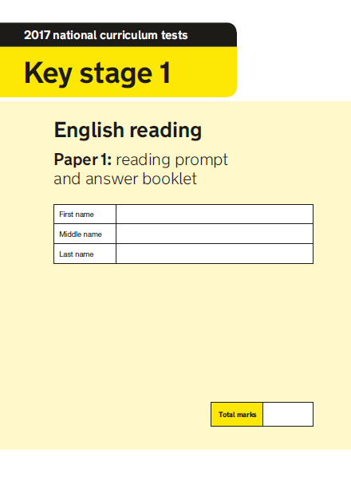

Slide 18
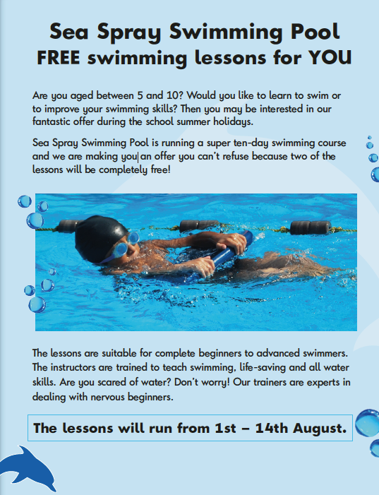
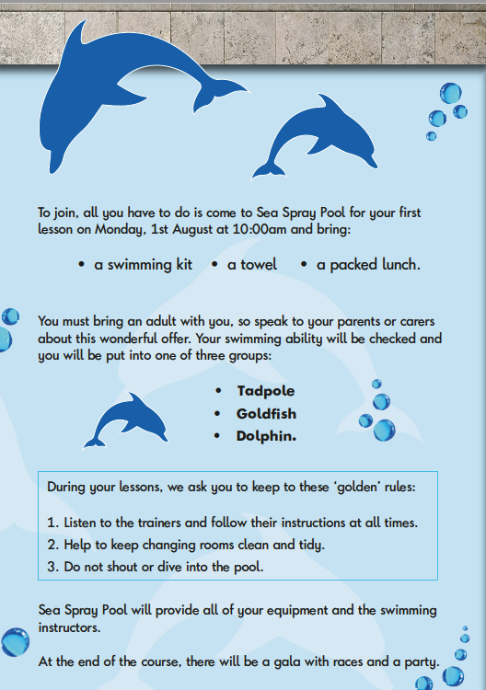

Slide 19
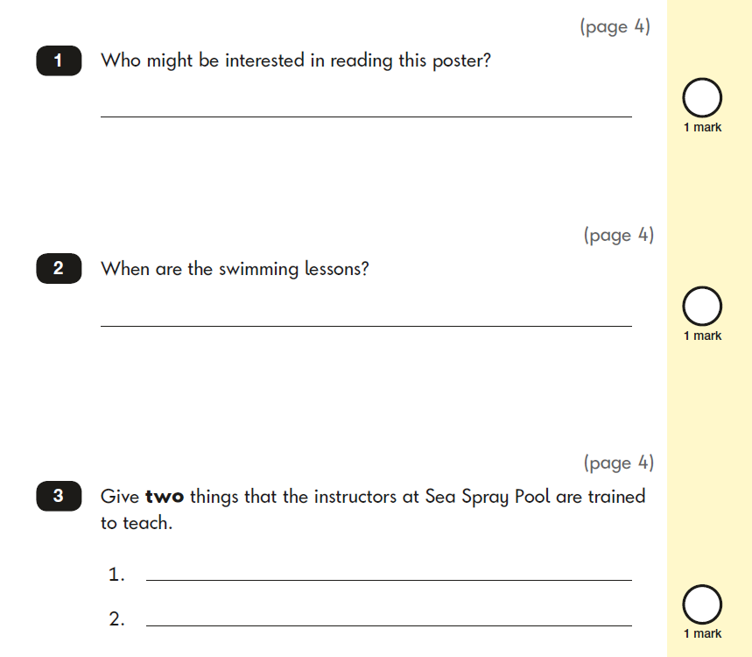
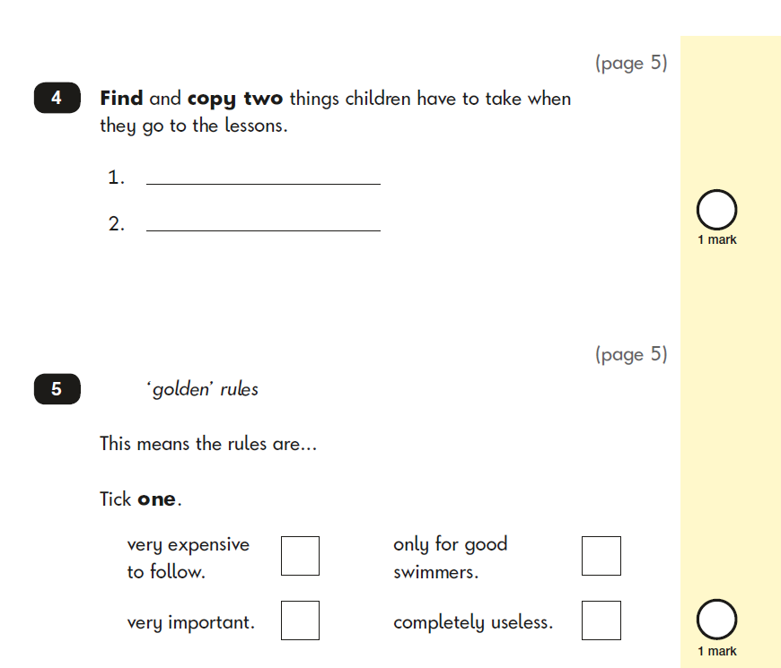

Slide 20
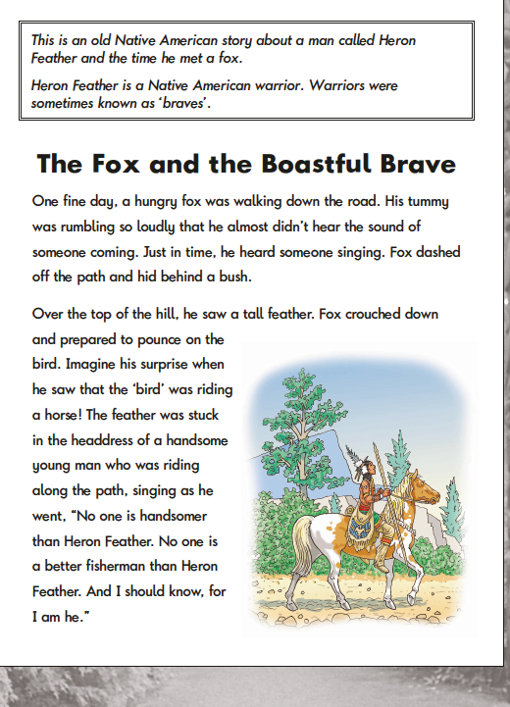

Slide 21
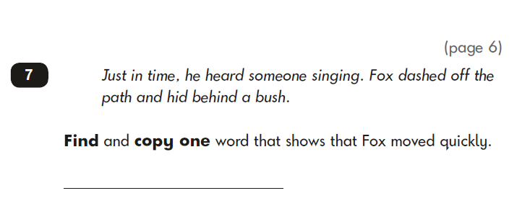
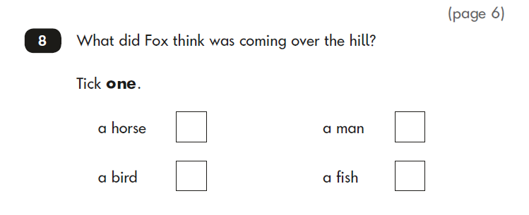
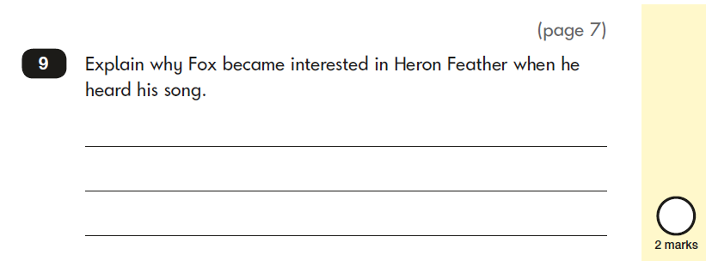

Slide 22

Once is never enough!
Re-reading helps children read more quickly and accurately.

Slide 23


Take control of the screens!
Encourage reading as a distraction free activity.

Slide 24


Be patient - When your child is trying to sound out an unfamiliar word, give him or her time to do so.

Slide 25
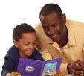

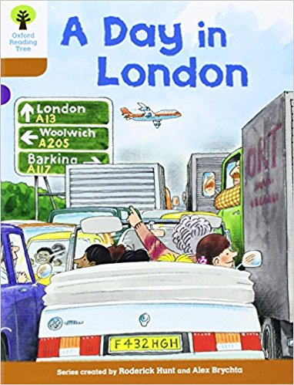
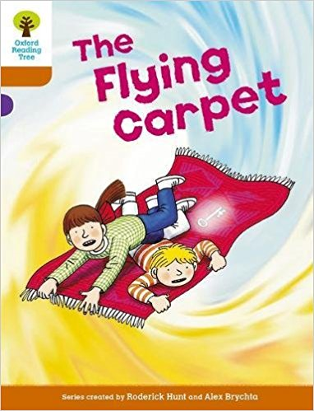
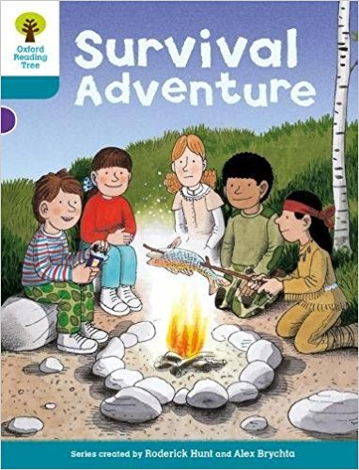
Take turns reading aloud
I read to you, you read to me - Model fluency while reading.

Slide 26
Key Stage 2
Developing fluency and reading comprehension…
Given...
Good phonic knowledge
An ability to apply phonic knowledge to decode unfamiliar words
A good sight vocabulary of irregular high frequency words ...

Slide 27
...there are still a great many skills to be developed
to become a successful reader...
Children have problems if they are unable to read in phrases so that “reading sounds like talking”.
Word by word reading often means the start of a sentence can’t be integrated with the end.
So we encourage them
not to read the spaces between the words!
to elide words that begin with vowels (pu ti ti na tin!)
Notes:
Comment on difference between printed and spoken word.
Talk about sliding finger instead of pointing.
Eliding vowels
Ability of brain to take in visual information – top half of words; finding words several lines below

Slide 28
However researchers have found that some pupils with both adequate decoding and satisfactory oral skills still have comprehension difficulties. (“Fake Reading!”) Cain and Oakhill
“A significant minority of pupils, despite being able
to read fluently and accurately have difficulty
gaining meaning from text. Students with strong
decoding skills can mask their difficulties in
comprehension and their problems often go
unnoticed” Clarke, Truelove, Hulme and Snowling 2014

Slide 29
Correct answers and real understanding ...
Read this...
Corandic is an emurient grof with many fribs; it granks with corite, an olg which cargs like lange. Corite grinkles with several other tarances, which garkers excarp by glarcking the corite and starping it in tranker-clarped strobs.
What is corandic?
What does corandic grank with?
How do garkers excarp the tarances from the corandic?
Notes:
This is how I read foreign texts – fluently but with little understanding!

Slide 30
  So...
  Accurate decoding is crucial, but does not guarantee comprehension...
‘When the mood took him,
Jimmy Hendrix played the guitar
upside down.’

Slide 31
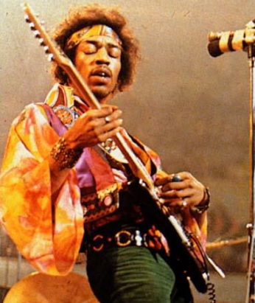

Slide 32
Developing Fluency and reading comprehension…
39/42 weak comprehenders failed
to answer these questions...
A surprise parcel arrived for Peter and Chloe.
Which word shows that they
were not expecting a parcel?
David rushed out of the room leaving
his mobile and keys on the table.
Which word shows that Dave had overslept?
(Cain 2010)

Slide 33
Developing fluency and reading comprehension…
Good comprehenders make more use of their background knowledge. As they read they generate inferences and therefore improve their memory of the text. (Yuki and Oakhill)
It is crucial for young pupils with limited life experiences to both listen to texts and read widely to extend their background knowledge so they can relate the text to:-
their own background knowledge – Book to self
their knowledge and understanding of the world – Book to world
other books they have read – Book to book

Slide 34
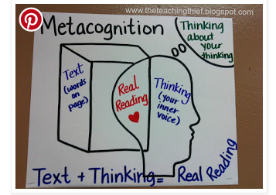

Making connections ...

Slide 35

...developing effective inference skills
Comprehension difficulties will not be solved by always answering someone else’s questions. Good readers ask their own questions to help their understanding
The photograph of the newly discovered star was on the front page.
What kind of star?

Slide 36

Newly discovered star one of hottest in Galaxy
OK – that kind of star!

Slide 37
Good readers...
...check that things make sense and notice when they have a meaning “breakdown”
...identify what is really important …key words… phrases… sentences… ideas
...ask questions, make predictions – and change their minds
...visualise – make mind pictures
...put together important parts to make a “summary so far” (gist), almost without thinking about it.
...add their own views and thoughts about what is happening. (synthesis)

Slide 38













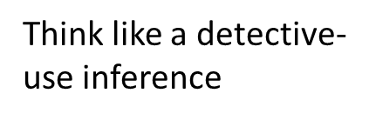



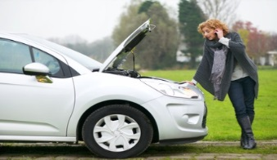
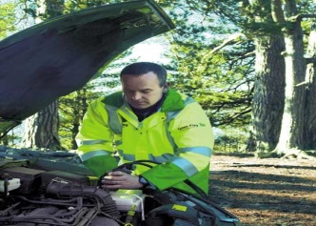

Strategies to help us understand and enjoy reading...
How…
why…?
Predict
Text to self
I
wonder
Text to world knowledge
Text to text
Use our background
knowledge and
connect to text
Predict, ask questions,
wonder… and read on to find out more...
Visualise
I think I’ve broken down
I’ve broken down but I have a plan to fix it
Watch out for VIP ‘key’ words
/phrases/ideas..
Notice meaning
breakdown…
…and put together to build GIST
…and repair it

Slide 39
How can you help?
Help your child to develop the skills –
Hear them read from their school reading books - they are matched to their technical skill level
Read books to them that are beyond their skill level but are of interest to them
Listen actively and discuss books with your children - ask questions to develop their thinking and for their opinions and predictions (see Bloom’s questioning)
Make time for reading together – one of the best things you can do to support your child’s learning!
Give them audio books to develop vocabulary and help them to visualise (and concentrate!)
Notes:
90% of the text can be read easily – ie no more than 10 errors in 100 words

Slide 42
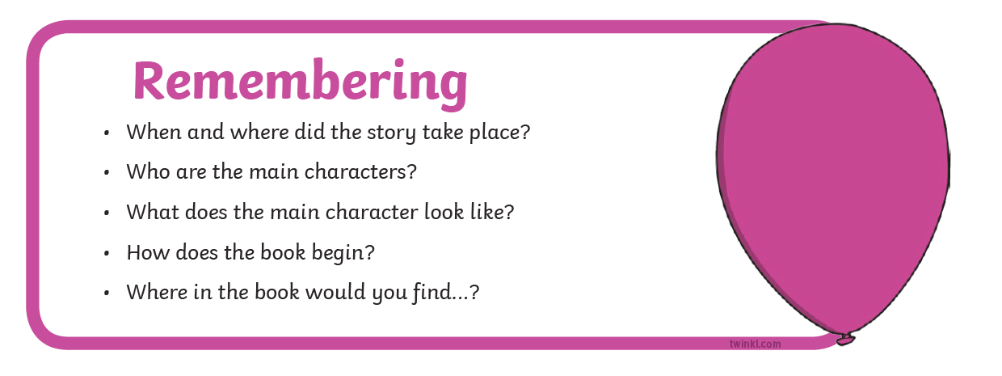
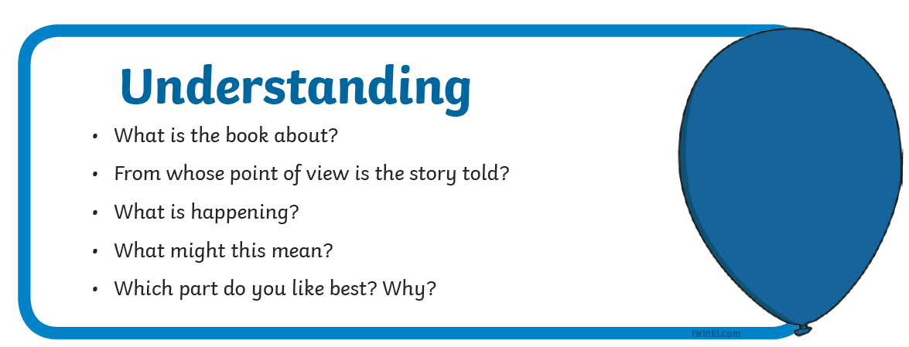
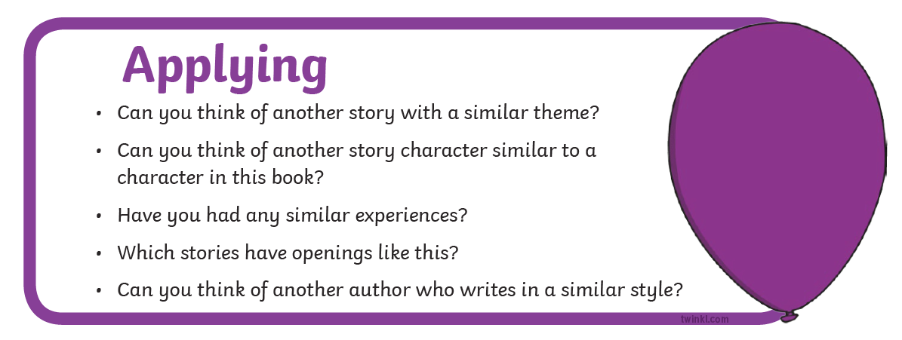
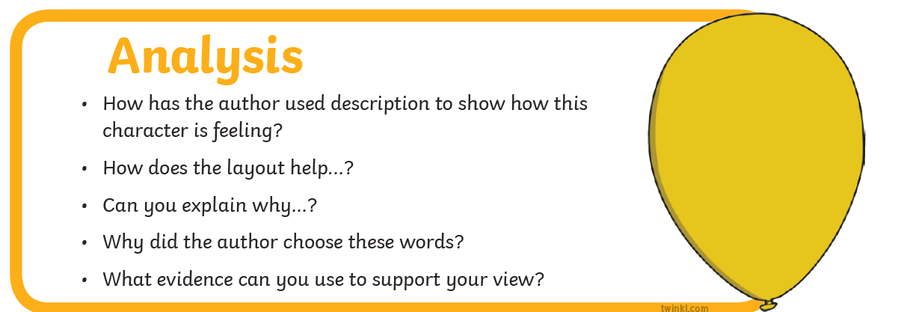

Slide 43


