Slide 1


Phonics
AT
Marston Moreteyne school
Non-negotiables for a consistent approach.

Slide 2
Consistency
Pronunciation of phonemes
Use of terminology
Sequence and progression through scheme
Support materials used
Teaching routines and mantras

Slide 3
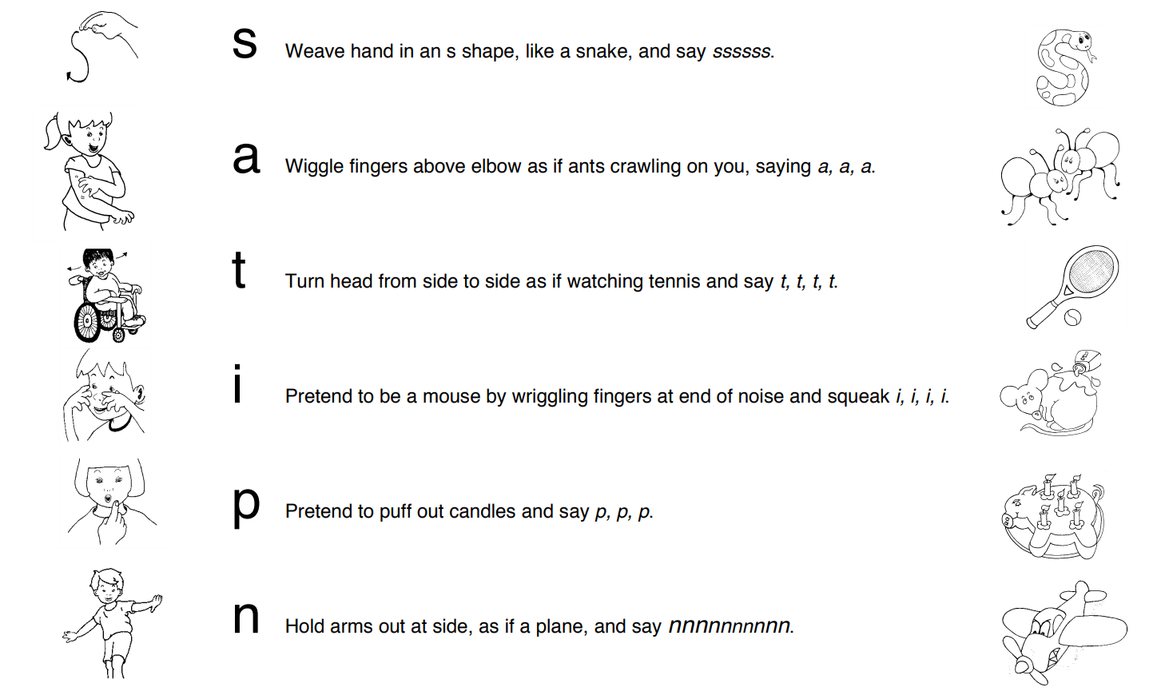
correct pronunciation of phonemes
Jolly Phonics Letter Sounds (British English) – YouTube

Slide 4
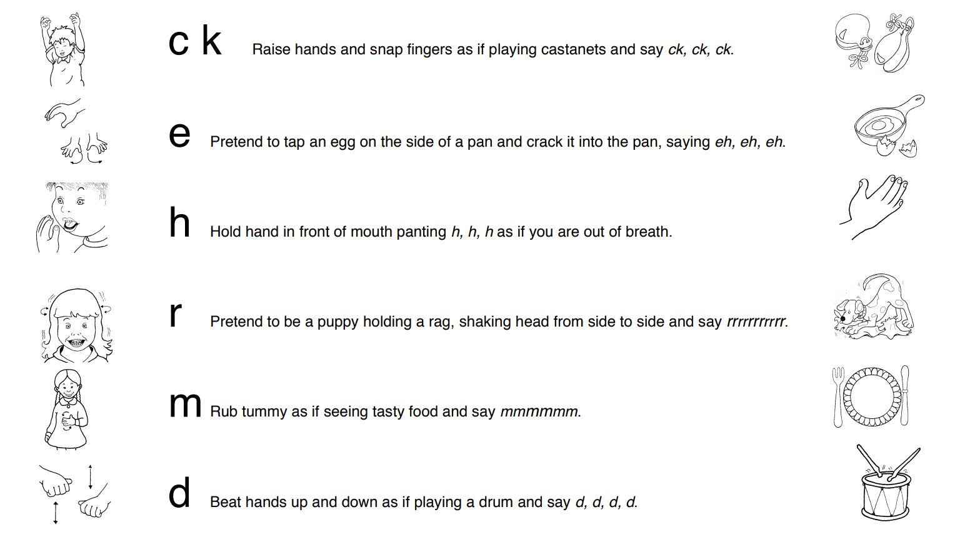

Slide 5
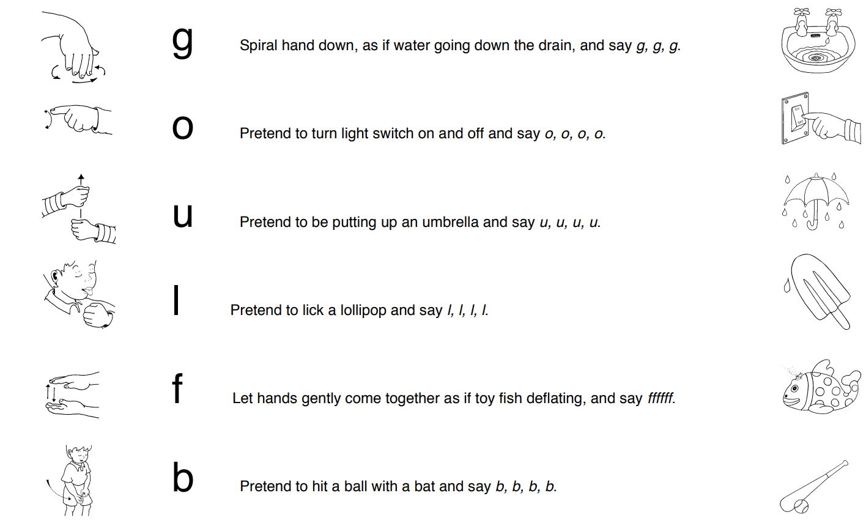

Slide 6
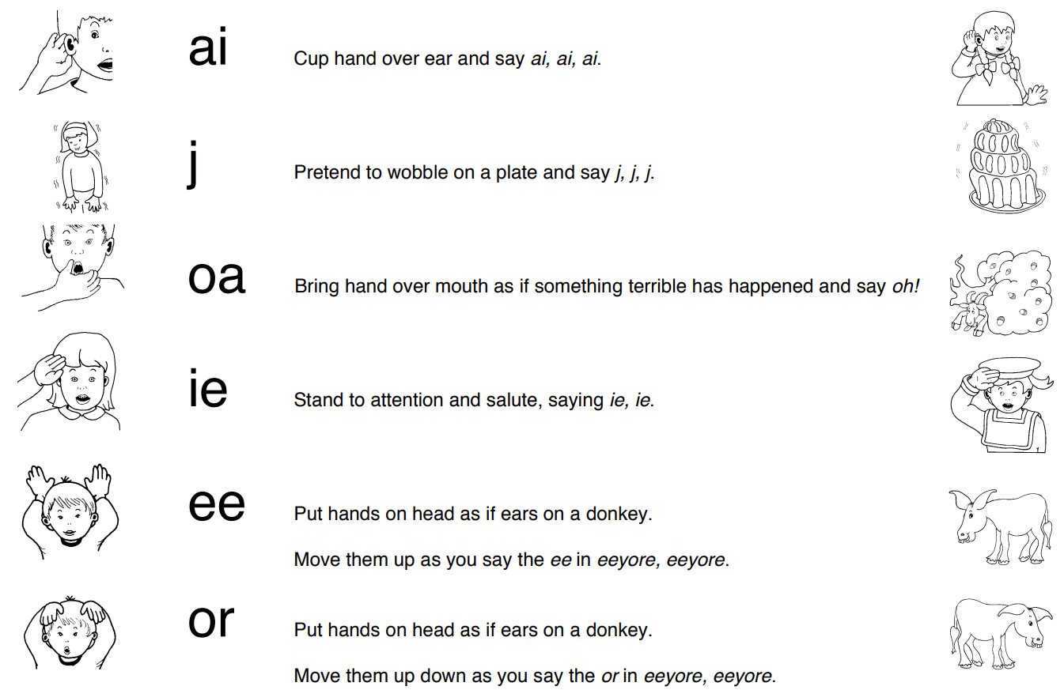

Slide 7
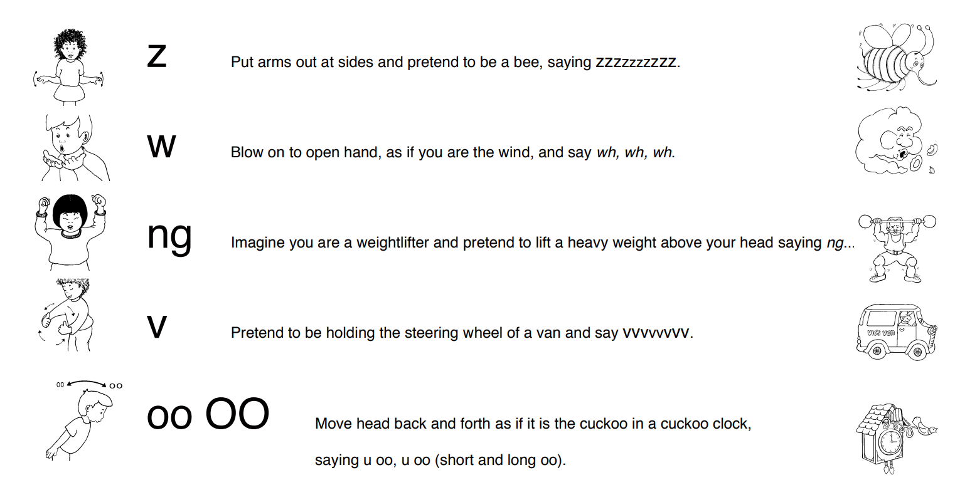

Slide 8
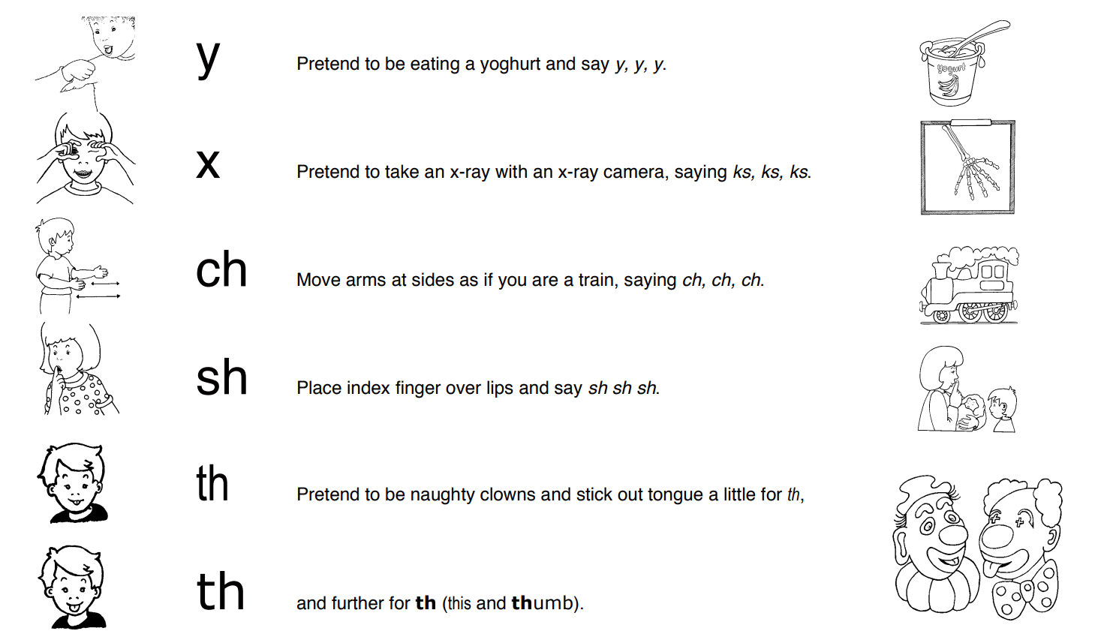

Slide 9
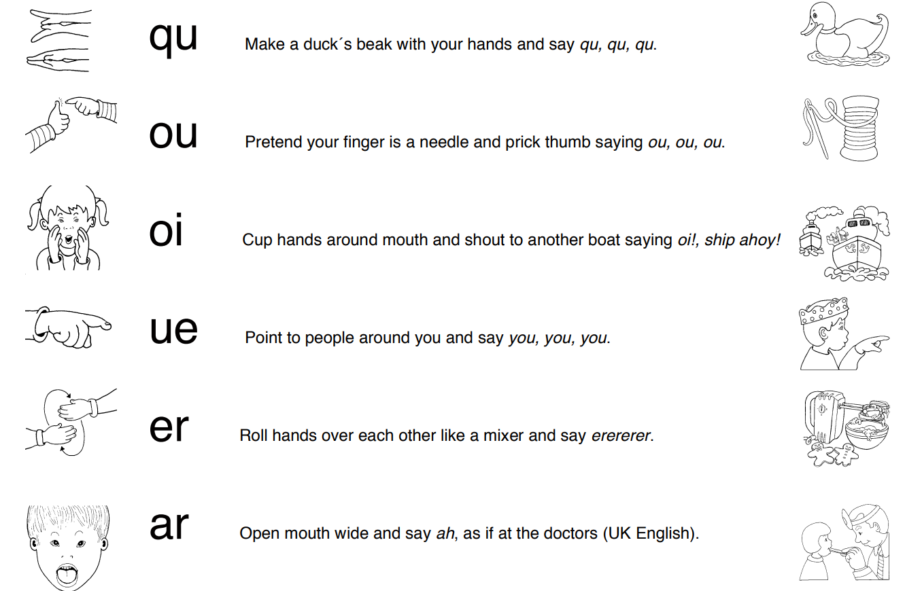

Slide 10
terminology
Blending
Putting together individual sounds to make words for reading. Before they can do this to read written words they need to be able to blend orally (hearing the sounds to merge them together).
Chunking
Is when you look for ‘chunks’ in words that you already know so you don’t have to sound every part out. For example the word band has the high frequency word ‘and’ that children may know. Therefore they can blend ‘b’ and ‘and’ together rather than sound all four sounds out.
Common Exception Words (also known as Tricky Words)
Words that appear frequently in print. It is worth learning these rather than having to sound them out each time as they appear so often. They are also known as sight words.
A Tricky Word is one which doesn’t follow phonics rules (or doesn’t follow the rules that the children have learnt yet) and you just have to learn it – for example – the, no, I (they are not pronounced phonetically – /t/ /h/ /e/)

Slide 11
Consonant Cluster or Blend
This is when two or three consonants are part of a word. For example ‘st’ in star or ‘spr’ in spray. Cluster is used when it is written and blend is used for when you say speak.
Decoding
When you translate printed word into sounds to read. The opposite of encoding.
Digraph
Two letters that make one sound. For example ch, ph, th.
Encoding
When you translate the spoken word into sounds to spell. The opposite of decoding.
Grapheme
How you write the sound (phoneme) using a letter or number of letters. For example – the five letter word night consists of three sounds (phonemes): n/igh/t

Slide 12
Segmenting
Hearing a word and splitting it up into the individual sounds (phonemes).
Split Digraph
As with a digraph it is when two letters make one sound. However, the two letters are not next to each other. Eg. brake has has the split digraph a_e.
Syllable
Often described as a ‘beat’ in a word that can be clapped out. It has one vowel sound and can be spoken as one unit. Example – rainbow is two syllables rain-bow or elephant is three el-e-phant.
Trigraph
Three letters that make one sound. For example igh, air.

Slide 13
Homophone
When a word is said the same, but spelt differently and has more than one meaning, e.g. there, their and they’re
Letter Name
As it says – the names of a letters of the alphabet. Think ABC song! There are 26 in total.
Nonsense/ Alien Words
Words which are not real. For example ‘vish‘. These types of words are used in the Year 1 Phonics screening check.
Phoneme
A sound – not a letter. There are 44 sounds in the English language When you see something written as a sound it will have a forward slash at the beginning and end of the sound. For example /a/.
Quadgraph
Four letters that make one sound. For example – ough
Vowel
(a, e i, o u) A letter that is not a consonant

Slide 14
Support Materials…
Mnemonic flashcards and friezes from Jolly Phonics
Alphabet frieze and sound mats using the same mnemonics
Plain flashcards for lessons
Support staff to have mini sets of flashcards for practise throughout day
Consistent use of Jolly Phonics Interactive Whiteboard Resources.

Slide 15
Teaching routines
Lead adult and all resources the children need to look at should be placed front & centre, with children facing directly at them.
Follow the structure of the panning to ensure all components of the session are completed
Spotlight on lowest 20% - specific seating plan.
All children actively involved.
Interactive Whiteboard Resources Used to support lessons.

Slide 16
teaching sequence
All lessons to follow this sequence.
Revisit and review
Teach (action/song/story)
Letter Formation
Blending
Identifying Sounds in Words
Listen and Write (words and sentences)
Planned Word Bank of words to use
Tricky Words to focus on (read and spell)

Slide 17
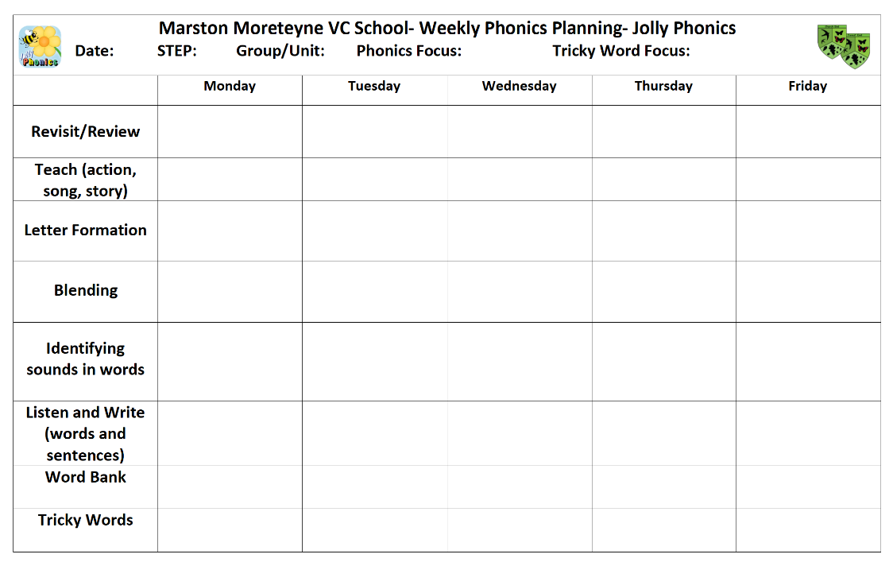
This planning format to be used across the school for lessons and interventions (as appropriate)

Slide 18
Teaching strategies /mantras
Use of ‘phoneme fingers’ to support segmenting and blending- rehearsing orally-always before writing.
Use of arm/hand swish to support blending for whole class- to show that all children say the sounds blended back into a word.
Use of ‘My Turn, Your Turn’ to ensure children listen to high quality model and learn through repetition.
Use of signal to indicate to whole class when they can say the blended word (push word card forward)

Slide 19
Teaching strategies - blending
Step 1 = oral blending- This starts in Pre-School and continues, as necessary as children can hear all sounds within a word (no letters at this point).
Step 2 = blending using individual letter cards/tiles on pocket chart/magnetic board etc.
Step 3 = blending to read whole words (flashcards)
Step 4 = chunking multi-syllabic words, including prefixes and suffixes.

Slide 20
Teaching strategies – role of the TA
    (Within whole class sessions)
TAs who support this session will need to…
Sit facing the children to enable them to monitor participation
Use listening cue cards to support behaviour voicelessly
Model good participation
Sit near to the lowest 20% to maximise their interaction with adults throughout the session
Provide praise (through use of non-verbal signs) for good participation.
Use small whiteboard to support targeted visual aids

