Slide 1


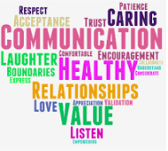
Relationship
Education
Thursday 20th October
Marston Moreteyne VC School

Slide 2
School Policy Rationale
Relationships Education and Health Education is compulsory in all state schools (Relationships and Sex Education is statutory in Secondary Schools). It provides, ‘…the key building blocks of healthy, respectful relationships, focusing on family and friendships, in all contexts, including online.’ (Relationships Education, Relationships Sex Education (RSE) and Health Education DFE 2019) These building blocks equip children with the understanding and knowledge that they will need in their everyday lives. These are important life skills about interacting and communicating with others. Relationships Education is an umbrella term for all teaching and learning we offer pupils, to help them to develop skills for relationships and informed decision making and is delivered within the wider PSHE curriculum.

Slide 3
What Are Schools Required to Teach?
Relationships Education (Primary School)
Health Education
Full statutory guidance can be found here:
https://www.gov.uk/government/publications/relationships-education-relationships-and-sex-education-rse-and-health-education

Slide 4
Aims
Relationships Education is firmly rooted within the framework for Personal, Social, Health and Economic Education (PSHE). In our school, we aim through explicit and implicit learning experiences to:
Ensure Relationships Education is part of a child’s broad, balanced curriculum, integral to the basic curriculum of the school and part of the child’s all round development
Prepare children for healthy relationships in an online world
Foster self-esteem and respect for others as the cornerstone of good health education and therefore, good relationships
Nurture a partnership between caring adults – governors, teachers, non-teaching staff and parents – to ensure sensitive support for children as they grow and mature
Encourage children to enjoy relationships based upon mutual trust and respect, free from any abuse

Slide 5
Aims continued
Generate an atmosphere where questions and discussion on age appropriate sexual matters could take place without embarrassment
Listen to pupils’ own thoughts, feelings and concerns to ensure that their needs are met
Promote the spiritual, moral, cultural, mental, physical and social development of the children
Prepare children for the opportunities, responsibilities and experiences of life
Understand how to stay safe, know the importance of boundaries and how to report abuse or feelings of being unsafe
Help pupils develop a positive and secure personal identity, a sense of their own value and feelings of confidence and empathy
To ensure that all understand the importance of respecting others and accepting those who differ, yet challenging those behaviours and attitudes which exploit others

Slide 6
Families and people who care for me
Pupils should know:
how important friendships are in making us feel happy and secure, and how people choose and make friends
that families are important for children growing up because they can give love, security and stability
the characteristics of healthy family life, commitment to each other, including in times of difficulty, protection and care for children and other family members, the importance of spending time together and sharing each other’s lives
that others’ families, either in school or in the wider world, sometimes look different from their family, but that they should respect those differences and know that other children’s families are also characterised by love and care
that stable, caring relationships, which may be of different types, are at the heart of happy families, and are important for children’s security as they grow up
that marriage represents a formal and legally recognised commitment of two people to each other which is intended to be lifelong
how to recognise if family relationships are making them feel unhappy or unsafe, and how to seek help or advice from others if needed

Slide 7
Respectful relationships
Pupils should know:
the importance of respecting others, even when they are very different from them (for example, physically, in character, personality or backgrounds), or make different choices or have different preferences or beliefs
practical steps they can take in a range of different contexts to improve or support respectful relationships
the conventions of courtesy and manners
the importance of self-respect and how this links to their own happiness
that in school and in wider society they can expect to be treated with respect by others, and that in turn they should show due respect to others, including those in positions of authority
about different types of bullying (including cyberbullying), the impact of bullying, responsibilities of bystanders (primarily reporting bullying to an adult) and how to get help
what a stereotype is, and how stereotypes can be unfair, negative or destructive
the importance of permission-seeking and giving in relationships with friends, peers and adults

Slide 8
Caring Friendships
Pupils should know:
how important friendships are in making us feel happy and secure, and how people choose and make friends
the characteristics of friendships, including mutual respect, truthfulness, trustworthiness, loyalty, kindness, generosity, trust, sharing interests and experiences and support with problems and difficulties
that healthy friendships are positive and welcoming towards others, and do not make others feel lonely or excluded
that most friendships have ups and downs, and that these can often be worked through so that the friendship is repaired or even strengthened, and that resorting to violence is never right
how to recognise who to trust and who not to trust, how to judge when a friendship is making them feel unhappy or uncomfortable, managing conflict, how to manage these situations and how to seek help or advice from others, if needed

Slide 9
Online relationships
Pupils should know:
that people sometimes behave differently online, including by pretending to be someone they are not
that the same principles apply to online relationships as to face-to-face relationships, including the importance of respect for others online including when we are anonymous
the rules and principles for keeping safe online, how to recognise risks, harmful content and contact, and how to report them
how to critically consider their online friendships and sources of information including awareness of the risks associated with people they have never met
how information and data is shared and used online

Slide 10
Being safe
Pupils should know:
what sorts of boundaries are appropriate in friendships with peers and others (including in a digital context)
about the concept of privacy and the implications of it for both children and adults; including that it is not always right to keep secrets if they relate to being safe
that each person’s body belongs to them, and the differences between appropriate and inappropriate or unsafe physical, and other, contact
how to respond safely and appropriately to adults they may encounter (in all contexts, including online) whom they do not know
how to recognise and report feelings of being unsafe or feeling bad about any adult
how to ask for advice or help for themselves or others, and to keep trying until they are heard
how to report concerns or abuse, and the vocabulary and confidence needed to do so
where to get advice e.g. family, school and/or other sources

Slide 11
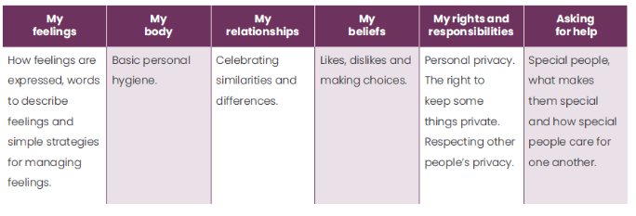
Acorns
YR
Notes:
Strands are revisited each year and built on within PSHE lessons

Slide 12
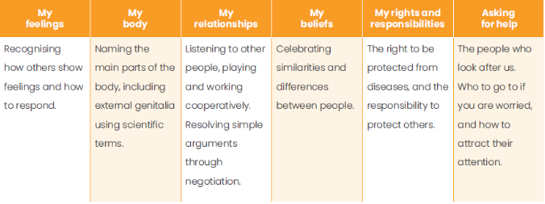
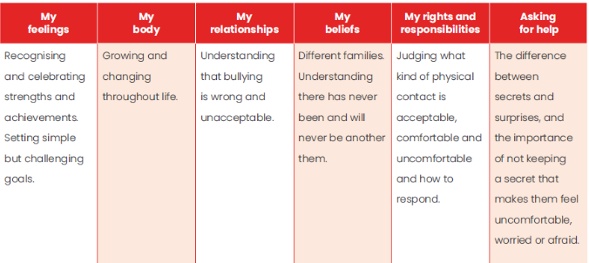
Year 1 and Year 2
Y1
Y2

Slide 13
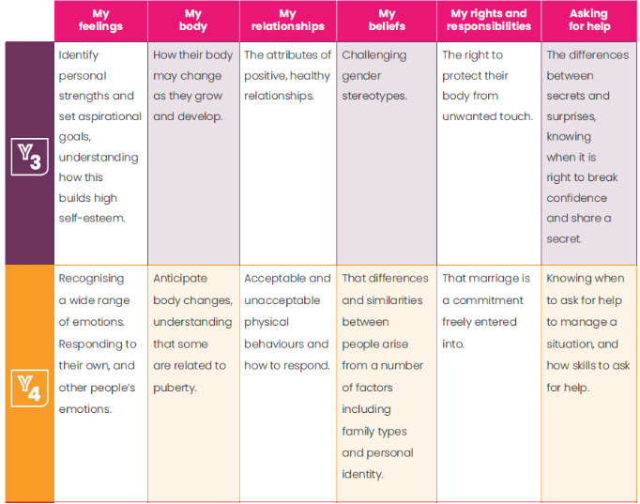
Year 3 and 4

Slide 14
Primary Curriculum overview
The focus in primary school is on building positive relationships, including friendships, family relationships and relationships with other children and adults
Establishing personal space and boundaries, showing respect, recognising and understanding the differences between appropriate and inappropriate/unsafe contact - physical or otherwise; these are the forerunners of teaching about consent, which takes place at secondary school
Teachers should talk to pupils about the features of a healthy relationship, which is more likely to lead them to happiness and security; this should include online safety. Relationships education also creates an opportunity to teach pupils about positive emotional and mental wellbeing, including how friendships can support good mental health
https://www.gov.uk/government/publications/relationships-education-relationships-and-sex-education-rse-and-health-education/relationships-education-primary

Slide 15
At the end of primary school, children should know about the following for Relationship Education:
Families and people who care for them | Including characteristics of a healthy family life, commitment, marriage, different types of relationships and families and relationships that make them feel unsafe
Caring friendships | Including characteristics of friendships, how to repair friendships, managing conflict and who to trust
Respectful relationships | The importance of respecting the similarities and differences of others, courtesy and manners, self respect, bullying and cyberbullying, stereotypes and how they can be negative and positive
Online relationships | Applying the same principles to relationships online and offline, people pretending to be someone they are not, keeping safe online and data sharing
Being safe | Appropriate boundaries, privacy, how to recognise and report feeling unsafe or uncomfortable

Slide 16
At the end of Primary School children should know about the following for Health Education:
Mental wellbeing | that mental wellbeing is a normal part of daily life, in the same way as physical health, that there is a normal range of emotions, how to recognise and talk about their emotions, the benefits of physical exercise, simple self-care techniques, that bullying (including cyberbullying) has a negative and often lasting impact on mental wellbeing and where and how to seek support
Internet safety and harms | that for most people the internet is an integral part of life and has many benefits, about the benefits of rationing time spent online, how to consider the effect of their online actions on others and know how to recognise and display respectful behaviour online and the importance of keeping personal information private, why social media, some computer games and online gaming, for example, are age restricted, that the internet can also be a negative place where online abuse, trolling, bullying and harassment can take place, which can have a negative impact on mental health and where and how to report concerns and get support with issues online
Physical health and fitness | the characteristics and mental and physical benefits of an active lifestyle, the importance of building regular exercise into daily and weekly routines and how to achieve this; for example walking or cycling to school, a daily active mile or other forms of regular, vigorous exercise, the risks associated with an inactive lifestyle (including obesity), how and when to seek support including which adults to speak to in school if they are worried about their health
Drugs, alcohol and tobacco | the facts about legal and illegal harmful substances and associated risks, including smoking, alcohol use and drug-taking.
Health and prevention | how to recognise early signs of physical illness, such as weight loss, or unexplained changes to the body, about safe and unsafe exposure to the sun, and how to reduce the risk of sun damage, including skin cancer, about safe and unsafe exposure to the sun, and how to reduce the risk of sun damage, including skin cancer, the importance of sufficient good quality sleep for good health and that a lack of sleep can affect weight, mood and ability to learn, about dental health and the benefits of good oral hygiene, about personal hygiene and germs, the facts and science relating to allergies, immunisation and vaccination.
Basic first aid | how to make a clear and efficient call to emergency services if necessary, concepts of basic first-aid, for example dealing with common injuries, including head injuries
Changing adolescent body | • key facts about puberty and the changing adolescent body, particularly from age 9 through to age 11, including physical and emotional changes, about menstrual wellbeing including the key facts about the menstrual cycle.

Slide 17
Right to Withdrawal
Parents cannot withdraw their child from any part of the Relationships and Health Education aspects of the RSE curriculum. It is important for ALL children to be taught the content on such essential matters like friendships and keeping safe.
There are separate rules on withdrawing a child from Sex Education. Sex education is separate from the Relationships and Health curriculum and parents can withdraw children from some or all of the lessons on Sex Education. The head teacher must grant a parent’s request to withdraw a child beforehand, and it’s useful to have good conversations with parents so that they understand fully what their child will be taught.
Before making a request, parents should:
Ask the school about what will be taught in Sex Education, and when
Remember that the science curriculum in all maintained schools includes content on human development, which includes human reproduction
Remember there is no right for a parent to withdraw their child from the science curriculum

Slide 18
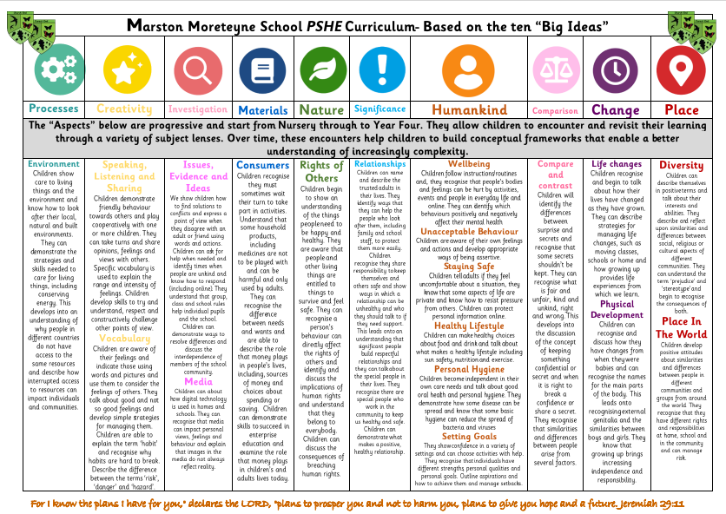

Slide 19
Safeguarding
Pupils may be affected by issues discussed in lessons.
The designated safeguarding lead or deputy and any other relevant staff, such as pastoral leads, will know what is being taught. This will enable them to identify and speak to relevant pupils, especially those who they know may have been directly impacted by issues covered in the lessons and those with adverse childhood experiences.
Teachers may need to deal with disclosures or concerns (e.g. of abuse or offending behaviour) in a way that safeguards pupils in line with school policies, especially the child protection policy.
Notes:
Teaching children the anatomically correct names for private parts increases a child’s self-confidence and positive body image. When adults are clear, unashamed and upfront about all parts of the body, this teaches the child that all parts of their body are important and no shame and stigma are attached to any part. Shame, stigma and embarrassment are taught, but can be untaught with the right approach. If we think about it, it’s actually quite bizarre to teach a child that their knee is called their knee, and that their ear is called their ear, but then call their vulva a ‘woowoo’ or one of the many names out there. Facilitate conversations with children using age-appropriate resources and books, for example anatomically correct dolls in your setting or books such as 'The Great Big Body Book' for the children to look at.

Slide 20
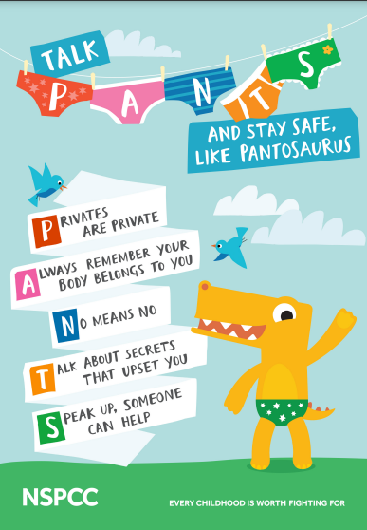
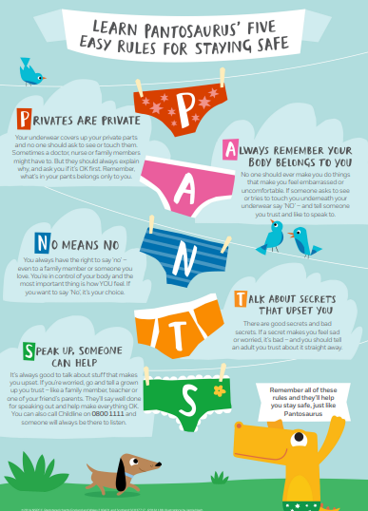
NSPCC PANTS
https://www.nspcc.org.uk/keeping-children-safe/support-for-parents/pants-underwear-rule/

Slide 21

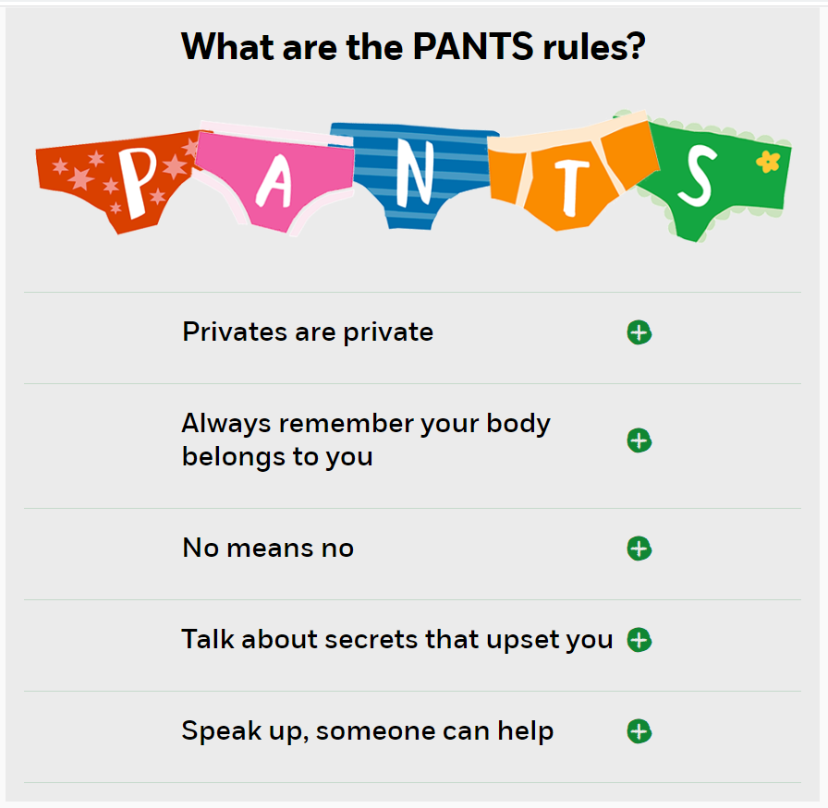
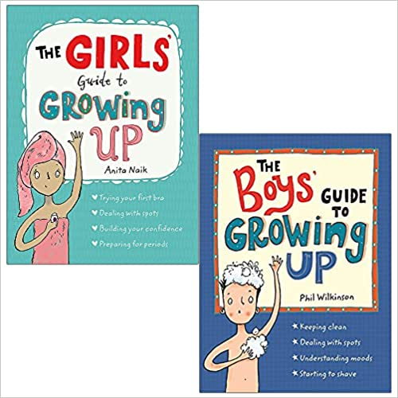




Slide 22


