Slide 1

Talking at home: Extremism

Slide 2






Talking at home
Here are some ideas on how to have conversations at home.
When to talk: try to find a time when there are fewer distractions around.
Where to talk: it’s best to talk in a relaxed, quiet and neutral place if possible.
How to talk: listen carefully, explain simply, ask questions and be patient.
Getting started…
Use these buttons below to move through the slides.
Find this button in the bottom right of your screen to start the slides.
Use the arrow keys to go forwards and backwards through the slides.
To go back to your normal screen, press the esc key on your keyboard.
–
Video Links & References:
Please use the notes section for alternative video links and references on each slide.
Don’t forget to vote…
At the end of this lesson, vote as a family. Do you all agree?
Notes:
Images:
https://icons8.com/

Slide 3



Can sharing stories prevent extremism?
This resource aims to encourage a conversation at home about how people’s personal stories and experiences can help us to learn about extremism and understand how to avoid being drawn into extreme ideas. The focus is particularly on how Coronavirus is impacting this. You can find more information on slide 23.
Notes:
Images

Slide 4







Starter: What is an extreme view?
Show your vote
On the next slide, you are going to see five different views. Where would you put them on the scale, from least to most extreme? Show your answer with your fingers. Can you explain why you think this?
Extreme¹:
A view that might seem unreasonable or unacceptable, often because it is hateful towards someone else.
Not extreme
Very extreme
Notes:
Images:
iStock
https://emojipedia.org/apple/
References:
1) https://dictionary.cambridge.org/dictionary/english/extreme

Slide 5
Starter: What is an extreme view?
Extreme¹:
A view that might seem unreasonable or unacceptable, often because it is hateful towards someone else.
Everyone should be able to live wherever they want.
People who eat meat should be punished.
Girls shouldn’t play football. They ruin the game.
People who commit a crime should be in prison forever.
We should all have the same religion.
Not extreme
Very extreme
Notes:
Images:
iStock
https://emojipedia.org/apple/
References:
1) https://dictionary.cambridge.org/dictionary/english/extreme

Slide 6




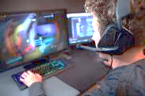
Why should we talk about this?
You will see this icon on every slide. Find out more on slide 19.
What’s different?
As a family, discuss how your life has changed since the Coronavirus outbreak, especially your online life.
Challenge:
How much time are you spending online each day?
Coronavirus is having a significant impact on young people and families across the world, changing the way that we live, learn and communicate with others.
With schools being closed too, we’re all using the internet more than ever to play, learn and talk to our friends.
Although it doesn’t happen that often, unfortunately there are people online who use the internet, social media and gaming to spread extreme ideas.
Notes:
References
https://www.ltai.info/
Images
https://www.standard.co.uk/news/london/westminster-survivor-describes-being-thrown-like-a-rag-doll-over-khalid-masoods-car-a3517336.html
https://www.pinterest.co.uk/pin/104075441370483785/?lp=true
https://www.standard.co.uk/news/london/families-of-westminster-attack-victims-demand-end-to-online-extremism-a3740341.html
https://i2-prod.mirror.co.uk/incoming/article12638965.ece/ALTERNATES/s615b/EMB-Incident-at-London-Bridge.jpg
https://metro.co.uk/2019/09/20/hollyoaks-deserves-praise-gets-tackling-far-right-extremism-uk-10778280/

Slide 7
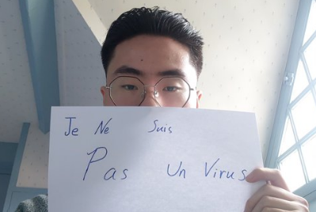
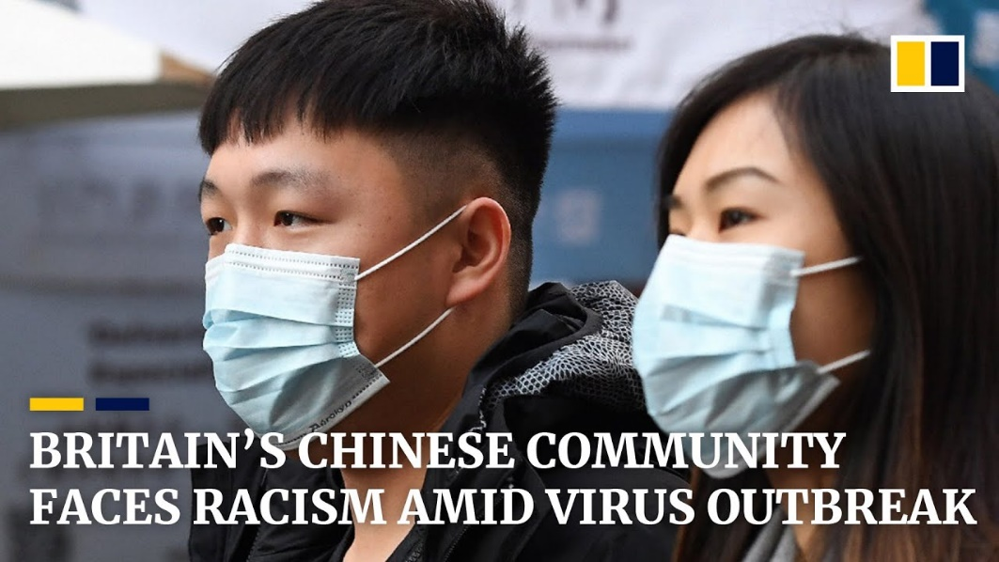
Why should we talk about this?
Misinformation and fake news can also play a part in spreading extreme ideas.
For example, in some places, misinformation and fear surrounding Coronavirus has led to East-Asian people being mistreated, including people avoiding them or making unkind jokes and comments about them.
Translation: “I am not a virus”
0:00-1:33
Watch (2-3 mins)
Click the image to watch a short video. How is this affecting different communiies in the UK?
Misinformation: wrong information
https://safeshare.tv/x/ss5ea028716221b
Notes:
Alternative video link: https://www.youtube.com/watch?v=gQILO63LobA
Images:
https://www.youtube.com/watch?v=gQILO63LobA
https://www.scmp.com/comment/opinion/article/3050542/coronavirus-triggers-ugly-rash-racism-old-ideas-yellow-peril-and
References:
https://youtu.be/2Z1pOEjajaY

Slide 8
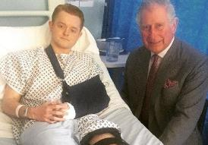




Why should we talk about this?
During the Coronavirus outbreak, there will be people who want to influence children and take advantage of the time they are spending online.
Talking about this as a family will help everyone in your house to understand the dangers that are out there.
The people you are going to hear from have shared their stories to help raise awareness and improve our understanding of the real effects of extremism.
However, it is important to remember that extreme groups also use stories to persuade people to become part of their organisation.
Notes:
References
https://www.ltai.info/
Images
https://www.standard.co.uk/news/london/westminster-survivor-describes-being-thrown-like-a-rag-doll-over-khalid-masoods-car-a3517336.html
https://www.pinterest.co.uk/pin/104075441370483785/?lp=true
https://www.standard.co.uk/news/london/families-of-westminster-attack-victims-demand-end-to-online-extremism-a3740341.html
https://i2-prod.mirror.co.uk/incoming/article12638965.ece/ALTERNATES/s615b/EMB-Incident-at-London-Bridge.jpg
https://metro.co.uk/2019/09/20/hollyoaks-deserves-praise-gets-tackling-far-right-extremism-uk-10778280/

Slide 9
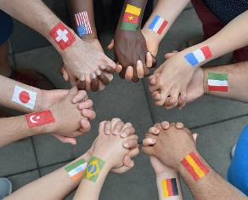

What stories do extremists tell?
Extremist groups believe that people who are different to them cannot live together peacefully.
Some common differences between people could include…
Religion
Politics
On the next slides you are going to read and see stories from the TV show Hollyoaks. They worked with the Counter Terrorism Police to show how extremist stories can affect people in real life.
Race
Gender
They will look out for vulnerable people who they can persuade to agree with their extreme views.
Read through this slide together. Does anything need explaining? Do you have any questions?
Vulnerable¹:
Able to be easily hurt or influenced.
Notes:
Images:
iStock
References:
1) https://dictionary.cambridge.org/dictionary/english/vulnerable

Slide 10

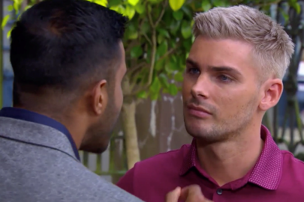
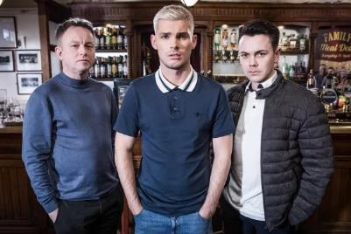
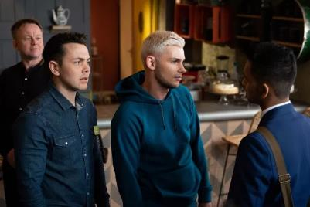
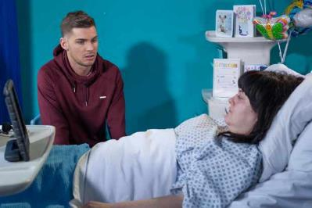
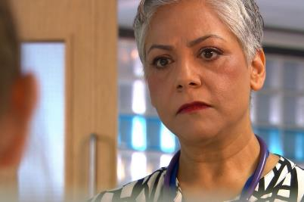
What stories do extremists tell?
0:00-2:53
Ste’s sister died in a terrible accident. He was very upset.
He blamed the doctor, Misbah, and thought she had made a mistake. He was angry at her.
Fortunately, Ste realised that these views were extreme and contacted Prevent for support. They helped him to leave the group safely.
Members of an extreme group recognised that Ste was vulnerable and pretended to be his friend.
Watch the film clip together
Hollyoaks worked with the police to make this story as similar to real life as possible. Watch the clip to hear the actors talk to Prevent about the story and how they help people like Ste.
They told Ste that people like Misbah should be blamed for most of his problems because they are Muslim. They tried to persuade him to damage a local centre that many Muslims use.
https://safeshare.tv/x/CLTmcMl2sF0
Notes:
Alternative video link: https://www.youtube.com/watch?v=CLTmcMl2sF0
References:
https://www.nspcc.org.uk/what-is-child-abuse/types-of-abuse/grooming/
Images:
https://www.radiotimes.com/news/2018-03-27/hollyoaks-tegan-is-awake-will-she-tell-ste-the-truth-about-ryan/
https://www.mirror.co.uk/tv/tv-news/hollyoaks-shock-misbah-maalik-decides-11827951
https://metro.co.uk/2019/06/13/hollyoaks-spoilers-ste-hay-discovers-the-shocking-truth-about-racist-jonny-baxter-9949481/
https://metro.co.uk/2019/05/02/hollyoaks-spoilers-ste-makes-a-shocking-decision-after-leela-tackles-racist-jonny-9394596/
https://www.facebook.com/permalink.php?id=351853981687338&story_fbid=1023822891157107

Slide 11

What stories do extremists tell?
0:00 -3:39
To make the storyline similar to real life, Hollyoaks also worked with John.
John used to be part of a far-right extremist group. He told his story to the writers at Hollyoaks and they used the information to come up with the storyline.
Far-right groups are often based on hate, believing that certain groups of people shouldn’t live with others.
Watch the video clip
Listen to John’s story. What lies did the extremist group tell him? Who helped him to leave the group?
There are racist groups that encourage hate and violence that are banned in the UK.
https://www.youtube.com/watch?v=IPUjp2xodwc
Notes:
Alternative video link: https://www.youtube.com/watch?v=IPUjp2xodwc
Images:
Supplied by Hollyoaks

Slide 12



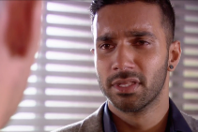

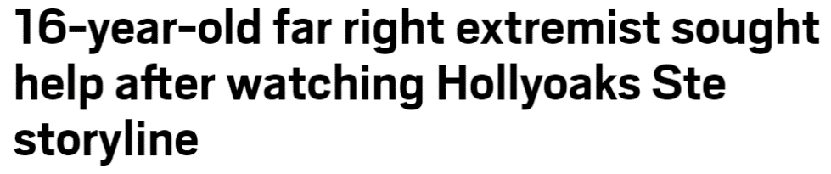
What stories do extremists tell?
Hollyoaks has been praised for teaching audiences how to spot the signs of extremism, both in person and online.
“These groups use social media to target vulnerable and lost people - and then try to [change] the way they see the world.”
Harvey Virdi, actress
The show has also encouraged people to speak about their experience. This headline was published in 2019:
Discuss this question together
Can showing extremism on TV help prevent it from happening in real life?
Notes:
Images:
1) https://metro.co.uk/2019/09/18/16-year-old-far-right-extremist-sought-help-watching-hollyoaks-ste-storyline-10767829/
2) https://thunderbirds.fandom.com/wiki/Harvey_Virdi
3) https://www.radiotimes.com/news/2019-06-06/hollyoaks-spoilers-ste-radicalisation-far-right-storyline-maalik-family/
4) https://metro.co.uk/2019/06/13/hollyoaks-spoilers-ste-hay-discovers-the-shocking-truth-about-racist-jonny-baxter-9949481/
5) https://www.radiotimes.com/news/2018-11-20/ste-attacks-misbah-over-tegan-death-as-hollyoaks-feud-turns-sinister/
References:
1) https://metro.co.uk/2019/09/18/16-year-old-far-right-extremist-sought-help-watching-hollyoaks-ste-storyline-10767829/
2) https://www.femalefirst.co.uk/tv/news/rishi-nair-hollyoaks-far-right-plot-hard-watch-1210754.html

Slide 13






The other side of the story
Family activity
On the next few slides you are going to hear from two people that were victims of terrorism here in the UK. With your family, think about this question.
Will sharing their stories help prevent extremism?
Terrorism¹:
A violent act for a political, religious or ideological cause.
Remember:
Not all extremist groups will commit terrorist or violent acts. However, all attacks are inspired by extremist ideas.
Notes:
References:
1) https://educateagainsthate.com/teachers/terrorism-definition/

Slide 14

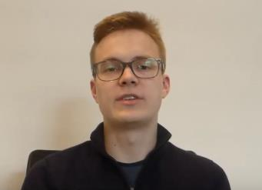
The other side of the story
Film clip
Watch Thomas* talk about that day. How do you think he felt? Have his views changed?
On 3 June 2017, three attackers drove a van into people walking along London Bridge¹. They were inspired by Islamic State (ISIS).
0:00-1:29
“The people who did this are also just human beings like you and me. No one is born a terrorist, but people are turned into terrorists by radicalisation.”
Discuss together
Do you agree with Thomas? Why/why not?
Radicalisation²:
Making someone become more extreme in their political or religious beliefs.
https://safeshare.tv/x/s5gQJQ5MwMo
Notes:
Alternative video link: https://www.youtube.com/watch?v=s5gQJQ5MwMo&feature=youtu.be
*Name changed to protect the privacy of the speaker.
Images:
https://www.standard.co.uk/topic/london-bridge-attack
References:
https://www.standard.co.uk/topic/london-bridge-terror-attack
dictionary.cambridge.org/dictionary/english/radicalization

Slide 15

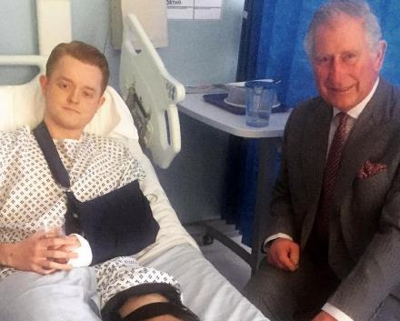
The other side of the story
On 22nd March 2017, there was a terror attack on Westminster Bridge. The attacker, inspired by Islamic State (ISIS), drove a car onto the pavement and injured more than 50 people.
Travis was injured in the attack.
0:00-1:22
Watch and think
Listen to Travis’ story. Can you answer his question?
“Had people […] that knew him spoken out about changes in his behaviour or in his life, how could [things] have been different?”
https://safeshare.tv/x/_jjHeB29acc#
Notes:
Alternative video link: https://www.youtube.com/watch?v=CQsnabyOwyc
Images:
iStock
https://www.standard.co.uk/news/london/westminster-survivor-describes-being-thrown-like-a-rag-doll-over-khalid-masoods-car-a3517336.html

Slide 16


What can you do?
Both Thomas and Travis wondered whether things would have been different if someone had reported the signs of extremist views earlier.
We all have a responsibility to help keep each other safe, and it is important that you know what to do if you see or hear any extreme ideas.
“It is our responsibility to make sure that our friends [and] family members are protected from these [extreme] ideas that will make them hurt others and […] harm themselves.”
  Reflection
  Have the stories helped to show you what you can do to help?
Challenge:
What could you do if you saw an extremist idea online? Who would you talk to about it?

Slide 17



What can you do?
  Discussion
  On the next slide, you will see three scenarios. Discuss each situation as a family, thinking about how you would feel, what you would do and who you would speak to.
Notes:
Images
1. https://upload.wikimedia.org/wikipedia/commons/thumb/b/b2/Gnome-computer.svg/2000px-Gnome-computer.svg.png
2. https://c1.staticflickr.com/4/3154/3114620946_020fb8a47d_b.jpg
3. iStock

Slide 18



What can you do?
1
You log on to a school computer and see a website that didn’t close. It says that all religions are evil and has some inappropriate pictures.
3
A young woman is yelling at the bus driver for not letting her off. She shouts an aggressive comment about the bus driver’s skin colour.
2
You spot a leaflet in your friend’s bag when you are getting ready for football club. On the cover it has this image.
©VotesForSchools2019
Notes:
Images
1. https://upload.wikimedia.org/wikipedia/commons/thumb/b/b2/Gnome-computer.svg/2000px-Gnome-computer.svg.png
2. https://c1.staticflickr.com/4/3154/3114620946_020fb8a47d_b.jpg
3. iStock

Slide 19



What can you do?
When you see or hear something in your community that doesn’t sound or feel right to you, whether it’s at school, in your local town or on the bus, it’s always best to tell
a trusted adult.
You will probably choose to tell a different person depending on what you hear or see. It’s always best to tell a teacher if you’re at school, or a trusted adult if you’re outside of school, like a parent.
If you hear or see hateful or extreme actions or words and you don’t know who to go to, you can call Childline for free. They are open 24/7.
And you can find out more about staying safe online by searching “What is Prevent?” and visiting the LTAI website.
©VotesForSchools2019
Notes:
Image References
https://upload.wikimedia.org/wikipedia/en/7/78/ChildLine_logo.png
https://www.scunthorpe-united.co.uk/contentassets/f4ef4403e6ca4ef98cfeb6478408316b/kick-it-out-logo-black70-2975160_1600x9002/Large

Slide 20




What should families look out for?
Boredom could cause children and young people to engage with new groups or individuals and this can make them vulnerable to those who are looking to influence them.
Online radicalisation can be hard to spot because it is complex, but there are some possible signs to look out for:
Exploring new & unusual websites or forums
Changes in identity & language
Joining new or secret groups, talking to new people
Sharing religious, political or hate-based videos online
Radicalisers can target children and young people by messaging on popular apps and websites. They wait to see who responds before taking the conversations further on a private platform.
https://safeshare.tv/x/ss5dcc3cf735f43
Notes:
Images
https://www.pinterest.co.uk/pin/104075441370483785/?lp=true
https://www.manchester.ac.uk/discover/news/book-provides-rare-glimpse-inside-the-english-defence-league/
https://time.com/3281925/somalia-al-shabab/
https://i2-prod.mirror.co.uk/incoming/article12638965.ece/ALTERNATES/s615b/EMB-Incident-at-London-Bridge.jpg

Slide 21

Can sharing stories prevent
extremism?
YES
NO
Sharing stories means people get to know who we are. If we understand each other, we are less likely to move towards hate.
Sharing stories, like in Hollyoaks, makes people aware of the issue, and can even encourage them to speak out.
People are more likely to listen to and remember a story that they relate to.
Stories have been used for thousands of years to help teach us about right and wrong choices. They can teach us how to prevent extremism too.
There are many stories available that are trying to prevent extremism, yet the amount of hate crime has risen over the past year¹.
While stories might help promote understanding and reduce extreme views, they might not be enough on their own.
Stories can be used to teach us the wrong thing. It depends on who tells them.
Extremist groups also use stories to recruit and groom people. Stories like this are dangerous.
Notes:
References:
1) https://www.bbc.co.uk/news/uk-50054915

Slide 22


You can vote from home at… https://www.surveymonkey.co.uk/r/SSVGLQV
To have your voice heard!
If you have any issues, feedback or comments, email aisling@votesforschools.com
Notes:
Alternative video link: https://youtu.be/FoQ45XPO_WQ

Slide 23


Need more information or someone to talk to?
Children | Parents/Carers | Other useful links
Remember, you can always talk to a trusted adult, like a teacher or a family member, if you are at all worried about anything. | If you need to talk to someone about the concerns you have for a child, call the NSPCC helpline on 0808 800 5000. They are open 24/7. | To report any online material you think promotes extremism or terrorism, go to: https://www.report-terrorist-material.homeoffice.gov.uk/report
If you need to talk to someone and you’re not sure who to go to, call Childline, a confidential helpline for children, on 0800 1111 – they are open 24/7 (all the time!): www.childline.org.uk | DfE website Educate Against Hate gives teachers, parents and school leaders practical advice and information on protecting children from extremism and radicalisation: https://educateagainsthate.com/ | NSPCC launched a free 24 hour helpline on 0808 800 5000 for anyone worried about radicalisation and the impact of terrorism. They have access to trained counsellors.
 | Visit the “Let’s Talk About It” website, a guide which gives practical help and guidance on what to do if you think someone might be being radicalised: https://www.ltai.info/ | Report a hate crime online using this form: http://report-it.org.uk/your_police_force

Slide 24







What can you do…
These are indicators that they might need help, but you know your child best and we advise that you speak with them first. Check in with them and ask them about what they are viewing, who they are speaking to and how they are feeling. This might feel difficult, but here are some tips to help you:
Listen carefully to their fears and worries. There are some helpful tips here.
Avoid complicated and worrying explanations that could be frightening and confusing.
There is advice and support to help them understand Coronavirus
If they are finding it hard to cope with bereavement and grief - advice can be found here.
You can get more information from the following websites, these will help you understand why people sometimes need
more support if they have been radicalised, what is available and how to access it.
Notes:
Images & references
https://www.nspcc.org.uk/
https://www.internetmatters.org/
https://parentinfo.org/
https://www.npcc.police.uk/CounterTerrorism/HomePage.aspx
https://www.childline.org.uk/
https://www.thinkuknow.co.uk/
https://www.ltai.info/

Slide 25



Find out more at… www.votesforschools.com

