Slide 1
Emotional Regulation Activities
Ideas and slides that can be screen shared when working with families and children. There are additional notes for practitioners for each slide.

Slide 2
Get in the moment
Activities to support you to feel present
These are useful for managing stress and anxiety
When people are feeling overwhelmed it is difficult to ground yourself. Learning to be present in or focusing on a moment can really help people to feel calm.

Slide 3

The Time Machine
Travel back to your best:
Day
Self
Moment
Notes:
Resources- None
This activity is an example of mindfulness. Taking someone back to experience a moment is really powerful. Encourage the person to take deep breaths and close their eyes.
This activity is also good for a ‘brain break’
Some questions to ask:
What were you feeling?
Where did you feel those feelings in your body?
If those feelings were a shape/ colour/ weather how would you describe them?
What could you see, hear, smell, taste or touch? If one of these experiences were missing what do you imagine it would have felt like?
It should be optional if the person chooses to share what they were thinking about. If they don’t want to share their memory they might talk about how they felt.

Slide 4
Sensory ABC
Put 5 columns on a piece of paper (or you can screen share the whiteboard)
Write the senses in each column
Choose a letter of the alphabet and write down something in each column that starts with that letter
See | Touch | Hear | Taste | Smell
Notes:
Resources- pens and paper
This can be done as a competition with the worker or with those who are with them in their household. Who can come up with the answers quickly and who has the most creative answers.
This is useful for children who are perfectionists. It helps them to think flexibly. Not everything is fixed into one category
Differentiation:
Draw pictures or find objects in the room they are in

Slide 5
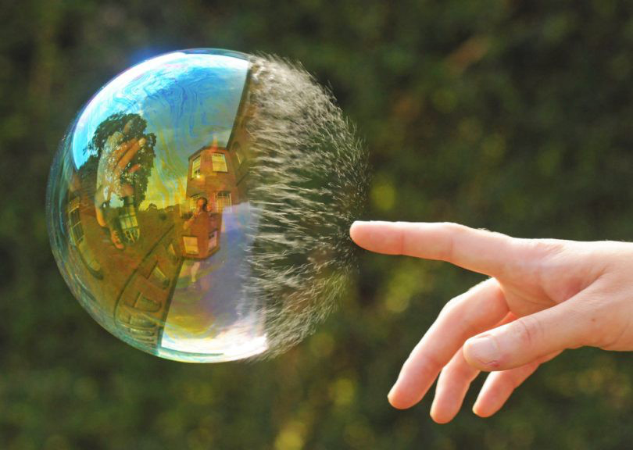
Go Slow Mo
Imagine doing an everyday task only in slow motion.
For example can you imagine taking off a jumper in slow motion.
Notes:
Resources- None
If someone is feeling really anxious and busy this is a good exercise to help them calm down. It can be really challenging to slow down but by doing this we learn to enjoy moments as they happen.
Talk about how it felt to slow down- was it liberating, relaxing, frustrating? This is a good activity to develop emotional literacy.
What did this feel like at the end? Were you tempted to rush. This is a good example of thinking about how we react to endings. Even if something is slow and takes time we always feel impatient at the end. For example we would wait for cakes to cook in the oven but would be tempted to eat them as soon as they are out even if we risk burning ourselves.
Talk about the end of the activity and how children and families feel about - currently this is a good way of discussing the easing of restrictions for lock down. Many people are in a rush for the end and this is a natural response. Think about what will make them feel safe over the coming weeks and months

Slide 6

Jump into a picture
Notes:
Resources- practitioner needs a nature picture (the one above can be used or another one of your choosing)
Take deep calming breaths and if you feel comfortable close your eyes
Imagine jumping into the picture
Take a look all around you what can you see outside of the picture, are you alone or can you see people- remember this is a safe place, take a deep breath- what does the air smell like, imagine taking off your shoes what does the ground feel like- if there is water put your toes in, take a walk around, find somewhere comfortable and take off your shoes, when you are ready get back up and put your shoes back on, start to stretch and come back to the room

Slide 7
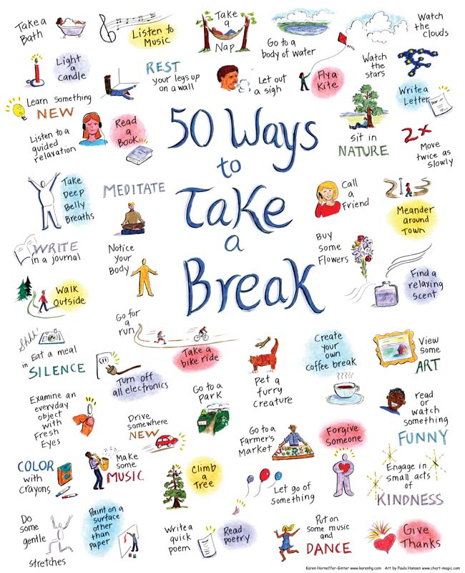
Take a break
Notes:
Taking some time out can be really important for us as professionals as well as the families and children we work with.
If you notice everyone is feeling a bit stressed 'take a break'
Some of these activities will need to be 'saved for later' due to social distancing or not being practical to do within a session. However you can set a goal for you and the family/ child to do this as soon as possible and it's a great one to discuss when opening your next visit.

Slide 8
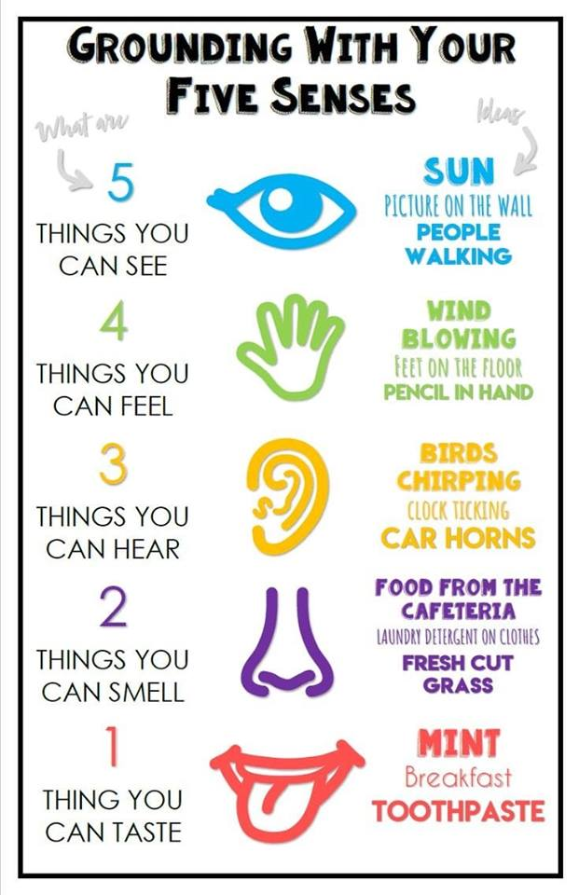
Grounding
Notes:
When someone is feeling overwhelmed grounding can be a way of feeling connected to their body again. Encourage those you are working with to recognise their 'early warning signs' and use this to help themselves feel calmer
This a great technique for people who struggle with high anxiety and can help prevent panic attacks

Slide 9
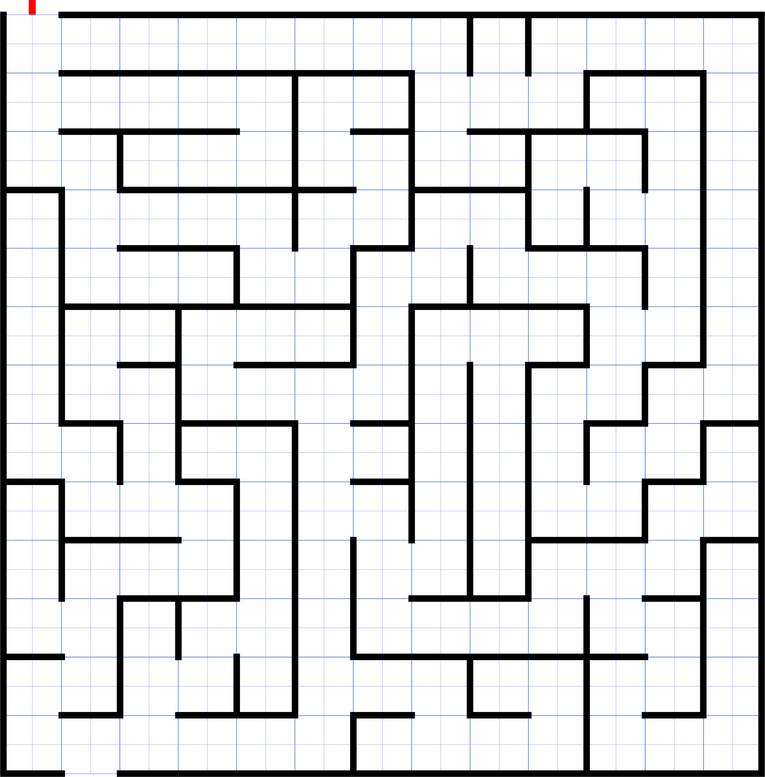
Maze walking
Use your finger to draw round the maze or imagine walking through this
Alternatively you can draw your own maze and do the same. Can you create a maze at home or in the garden to walk around?
Notes:
This is a useful activity to help with mindfulness. It helps a person focus on something in the moment.
This is also a useful activity to support with problem solving.

Slide 10
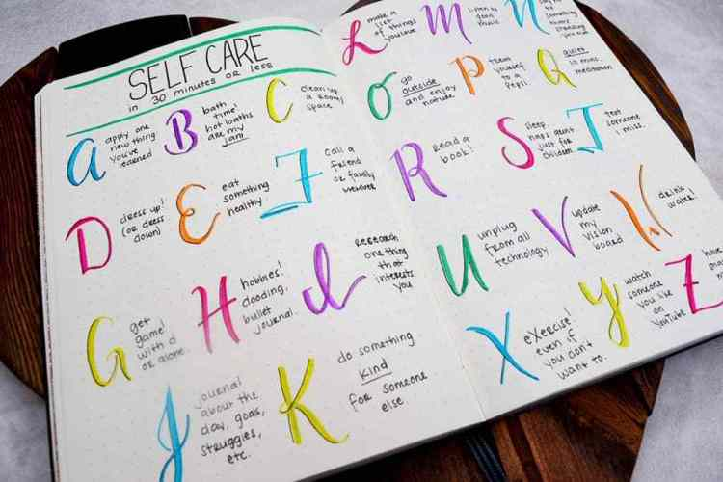
Self-Care ABC
Can you think about an activity to help with self-care beginning with each letter of the alphabet.
If you're feeling creative write this down and add pictures for each example
Notes:
Resources: Pens and paper
This is a useful activity to get people to think up creative and new ideas for self care

Slide 11
Get creative
Being creative helps with problem solving
Being creative also helps us to express feelings when we can’t find words

Slide 12

Take your pencil for a walk
Put your pencil or pen in the middle of the paper and move this round the paper in any way you like.
Fill the whole paper with marks but don't take the pen/ pencil from the page
When the page is full stop drawing
Take a look at the page. What shapes can you see? Are there any patterns? Are there any people, animals or objects? Shade these in.
Notes:
Resources- Pens and paper
This is a really useful activity to promote creativity in people who don’t think they are creative
This activity promotes mindfulness and feeling still and calm.

Slide 13

Heart Drawing
Draw a picture of a heart- leave space round the edge
Make a list of feelings words around the page. Write the words in different colours
Think back to the last week and what feelings you have felt
Colour the heart in with the colours of the feelings you have felt over the last week
Notes:
Resources: Paper and coloured pens/pencils
In this activity focus on the positives. Even in a bad week there will have been some good times and good feelings. Positive times and events do not go away just because there are also bad times. The positives stay with us and fill us with hope when remembered.
Our brains are hardwired to remember negative events and feelings more than positives. This is part of our survival instinct. We need to remind ourselves of all the good. Some people may need prompting to remember the good as well as the bad.
If a child or adult cannot think of one positive event think about the wellbeing of this person. What is there support network? Do they need to contact GP/ CAMH? Do they need urgent support? You may need to speak with wider family members to get a full picture of what is happening for this person.

Slide 14
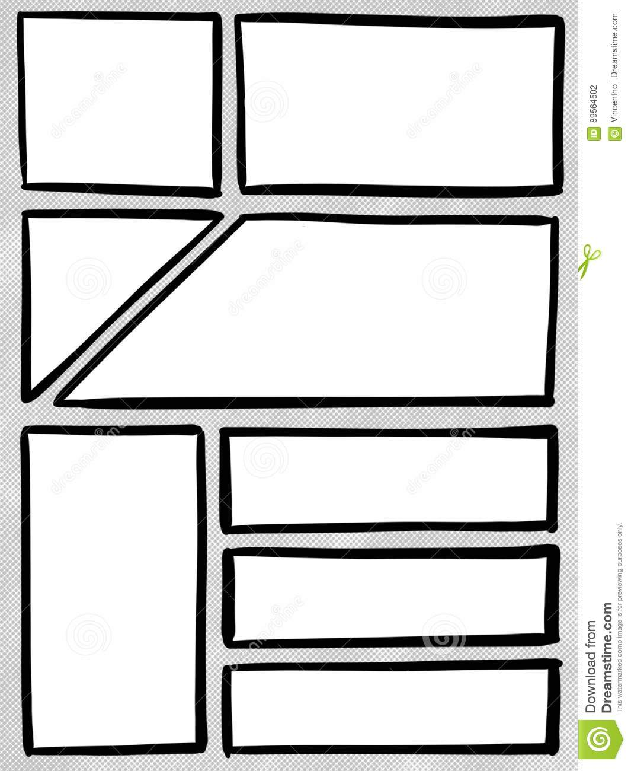
My Day
Can you draw your day as a comic book?
Notes:
Sometimes when anxiety is high people feel stressed and worried. By using drawing or writing down what is happening in your day this can really help to give focus and help you feel less stressed. It also gives you the opportunity to think about how to react in certain situations. This is particularly useful for children who struggle with managing overwhelming emotions and children with additional needs.

Slide 15
Breathing exercises
Deep breaths are crucial to emotional regulation
When we get anxious, angry or stressed breathing becomes unregulated and our heart rate changes. Deep breathing can help regulate the physical sensations in the body. This helps us to think clearly and make good decisions
It's important to practice breathing deeply when calm and relaxed. This encourages people to use it as a strategy when anxious or angry

Slide 16
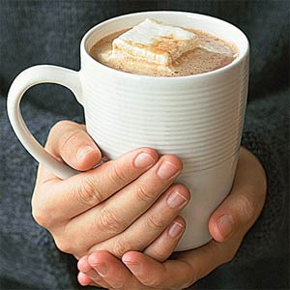
Hot chocolate
Notes:
Imagine you are holding a hot chocolate
Feel the warmth in your hands
Breath in through your nose- enjoy the smell
Breath out slowly
Smell is a very powerful sense. Smells can trigger powerful memories and take us straight back to an event, this could be good or bad. If we associate a smell with feeling calm each time we smell this it will help you to feel calm again.

Slide 17
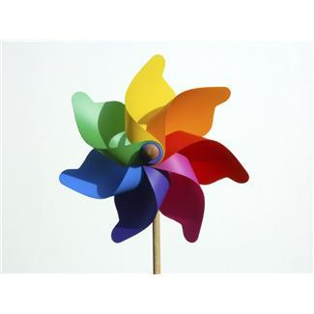
Colour Breathing
Think of a colour that feels calming to you right now
Sit comfortably with your feet on the floor
Take a deep breath in
Imagine you are breathing that colour up your body
As you breath in the colour comes up from the floor through your toes
With each breath in you fill your body with colour
Notes:
This is helpful for people to have an alternative focus when deep breathing. Having a focus can help stop the mind wander and help you to relax
Colour is important in our world and colour is a powerful way to evoke emotion and this can help us feel calm. Colour has different meanings to different people, for example for some people green will trigger thoughts of nature but for others it may make them think of infection, so it's important to let people choose their own colour.

Slide 18
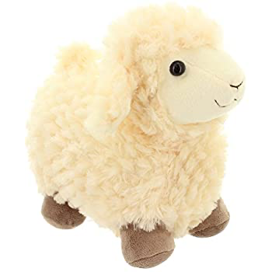
Toy bump
Lay flat on your back
Place a cuddly toy or another other figure onto your belly
Take deep breaths
Can you move the toy just by breathing
How much can you move the toy?
Notes:
Resources: Cuddly toys or other figures
Learning to breathe deeply is important. It's the deep breaths that reach the abdomen that help us to calm down when stressed.

Slide 19
Have some fun
“Laughter is the best medicine”
Often people feel really stressed and anxious, having fun and laughing helps people to relax
Laughing releases endorphins and dopamine the 'happy' hormones

Slide 20
Tell a joke
Come up with your own or use one of the examples below:
What did the big flower say to the little flower?
Why did the kid throw his clock out the window?
Why are fish so smart?
What do you call a cheese that’s not yours?
What does the ocean do when it sees it’s friends?
Notes:
Hi, bud!
Because he wanted to see time fly!
Because they live in schools!
Nacho cheese
It waves.

Slide 21
Would you rather
Have a pen that brought things to life or a rubber that erased real things?
Have the power to teleport or shapeshift?
Travel 5 minutes into the future or the past?
Explore space or the deep sea?
Lie to parents or lie to your friends?
Get myself into trouble or get my friends into trouble?
Be bullied or be the bully?
Only be able to whisper or only be able to shout?
Speak every language or play every instrument?
Meet a superhero or a cartoon character?
Notes:
This is a good activity to support with difficult conversations
Start and end on lighter fun questions to build trust and help regulate the person at the end

Slide 22
Mindset change

Slide 23
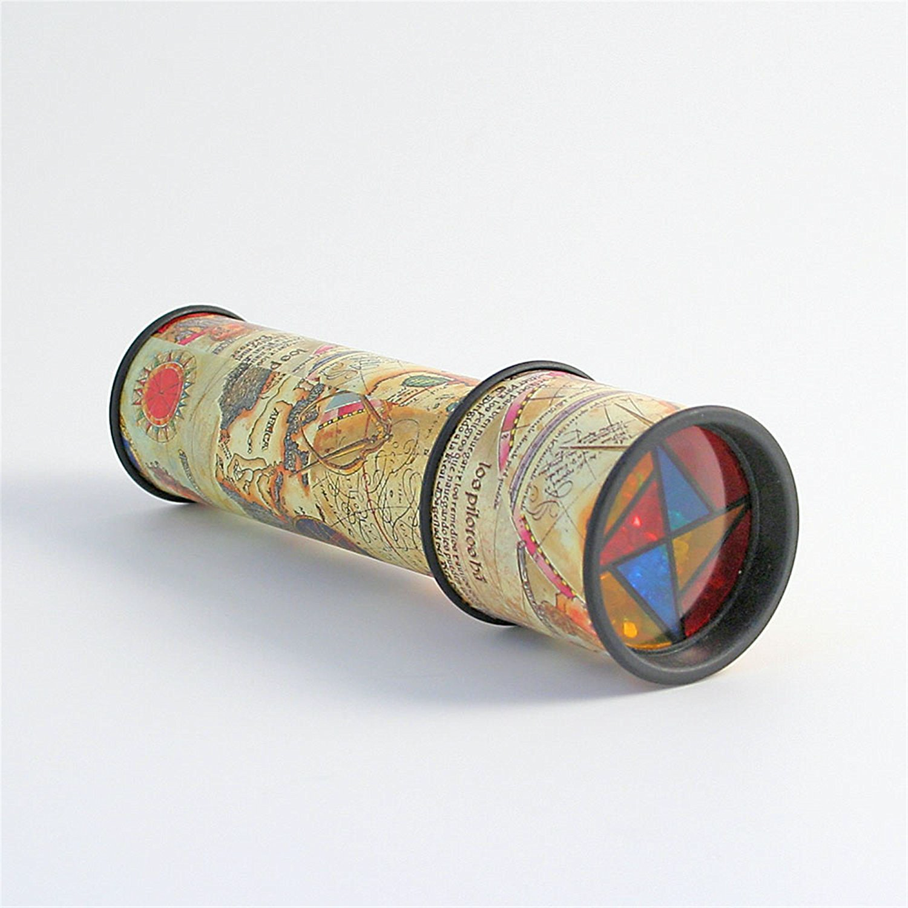
'When we change the way we look at things, the things we look at change'
Imagine you are looking down on the problem from a cloud
Imagine you are flying over it on a magic carpet
Imagine looking at the situation through a kaleidoscope
Notes:
Resources: None
When working with people who are 'stuck' or struggling to move past something this is a useful activity to help them to see things from a different perspective

Slide 24
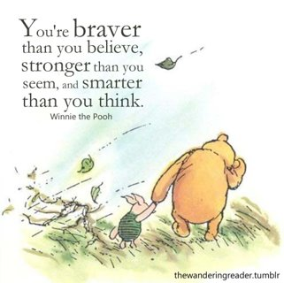
Share an inspirational quote
Notes:
Share something with meaning and talk about this. Talk about how it makes the person feel and all the ways it applies to them

