Slide 1


Slide 2


Slide 3
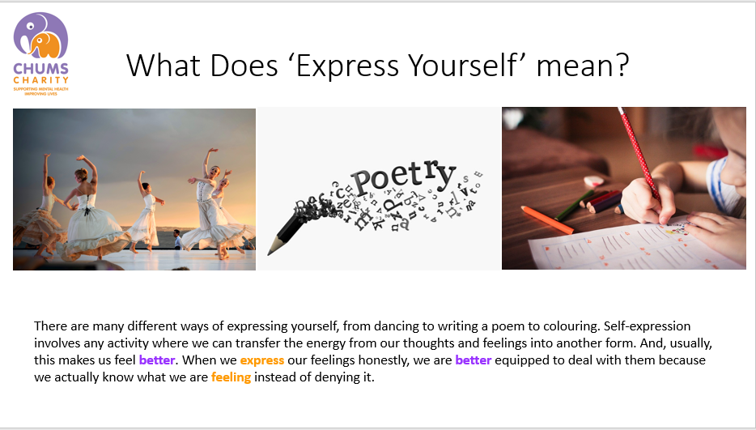

Slide 4
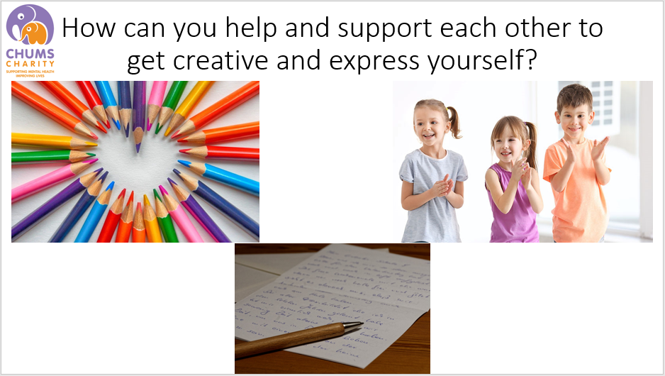

Slide 5



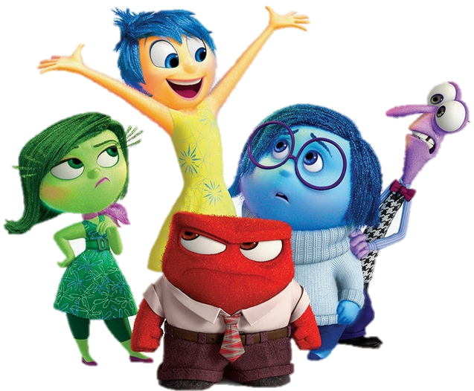

Recognise how you’re feeling!
To be able to express your feelings, you need to be able to know what you are feeling!
How many emotions can you name?
There are many ways we can recognise our emotions…
Our bodies can tell us a lot about how we are feeling...
If you feel shaky and sick before your performance, you might be feeling NERVOUS.
If you feel hot and out of control, you might be feeling ANGRY.
If you can’t stop laughing and moving around, you might be EXCITED!
Our body gives us lots of clues to how we feel, so next time you feel a little different, think about which emotion you might be feeling.

Slide 6
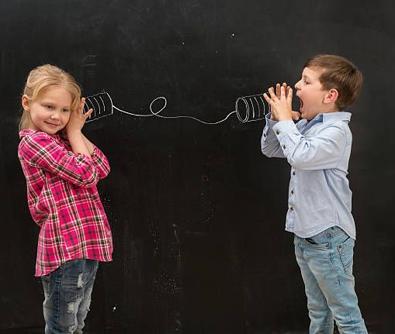
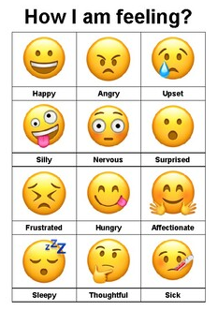
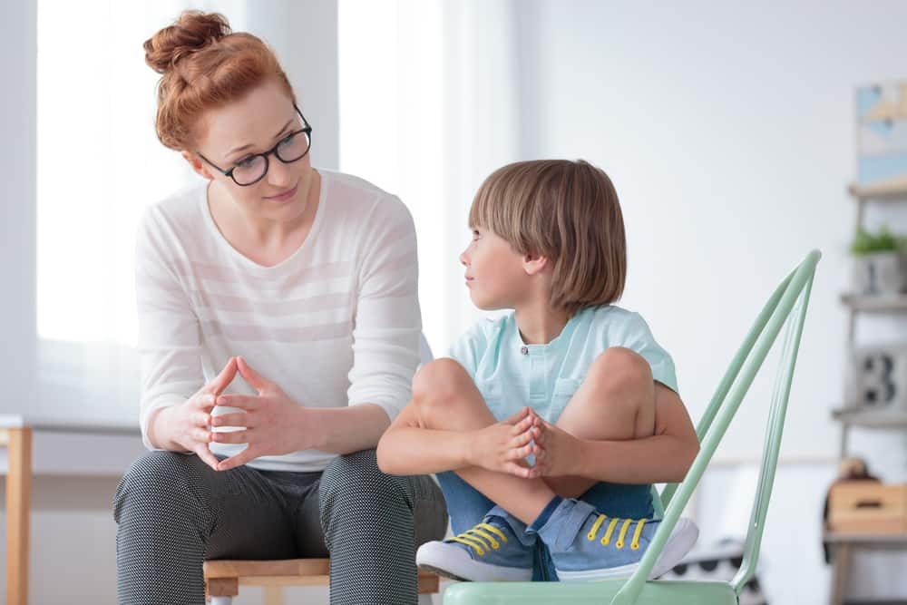
All of the feelings you named are normal and okay but being able to express them is so important!
Using Emoji charts at home or in your classroom is a great way to express how you are feeling using pictures!
You could make your own chart as a class and everyone can get involved!
It is so important you talk about how you are feeling- especially if you are feeling upset, angry or sad.
Talk to any of the adults in your life-
A problem shared, is a problem halved!
Being able to notice other peoples feelings is an amazing skill to have!
If you notice your friend isn’t feeling their best, be there for them and try something to make them feel better.
REMEMBER! If you are feeling very upset or angry, take some time out and do big, deep breaths.

Slide 7
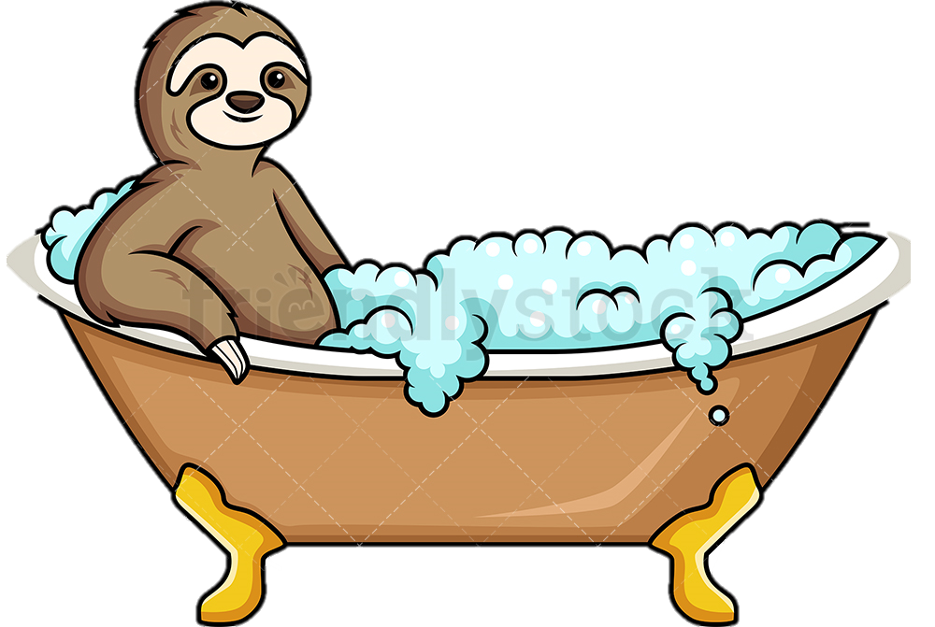
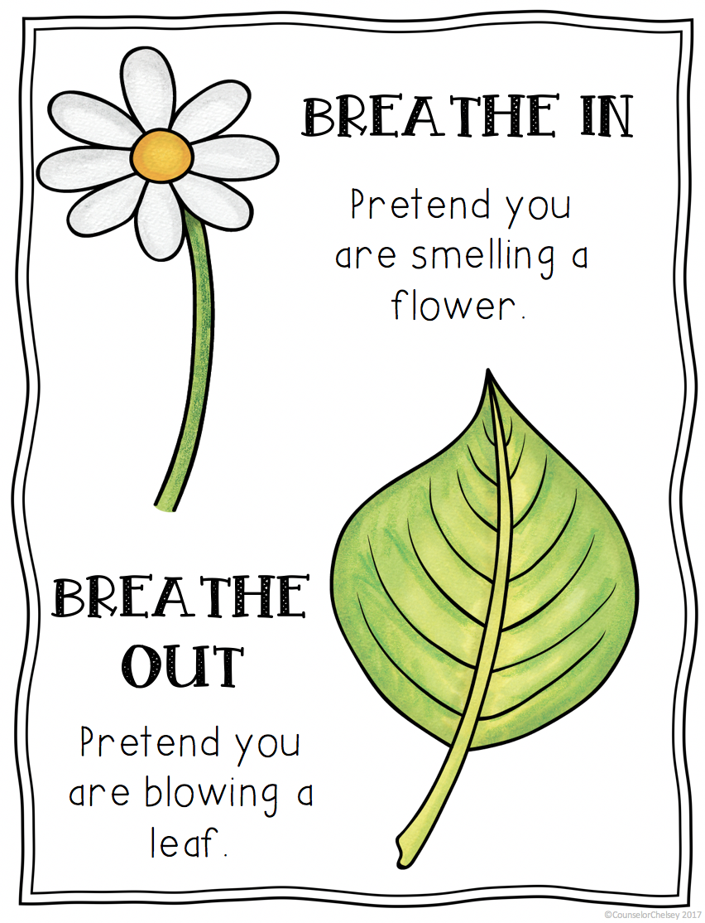
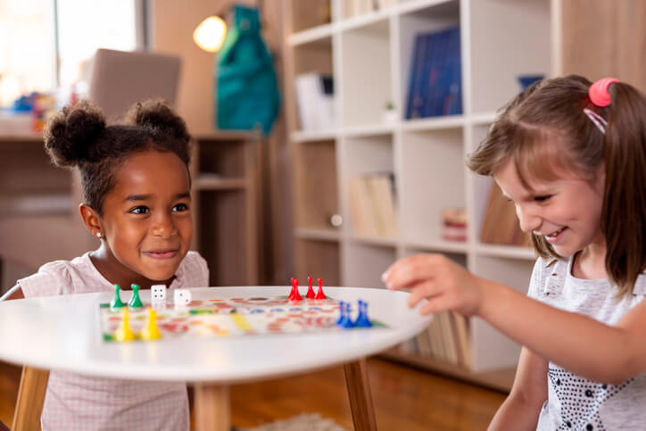
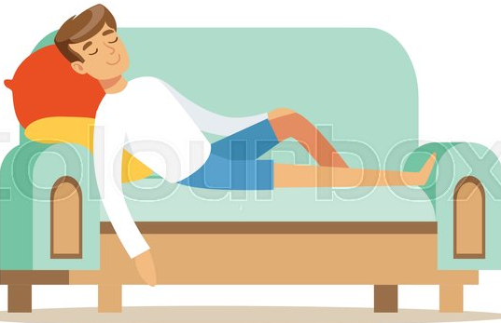
Do what makes you feel great!
Everyone is unique and enjoys different things. Doing the things you love makes you feel good and is a great way to express yourself!
Here are some ideas…
Let’s try this together!
Deep breathing can make you feel better if you are worried, upset or angry!
Do things that make you laugh and have fun!
This could be games with your friends, reading, colouring etc
Sometimes you just need to relax.
How about a bubble bath?
If you feel like you need some time on your own- that’s ok!
This might make you feel better after a tough day!

Slide 8
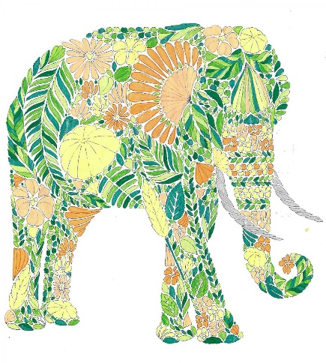
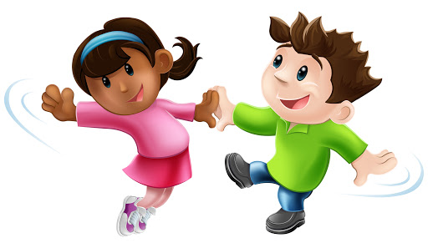
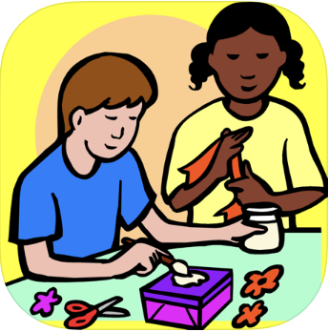
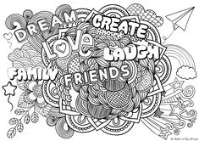
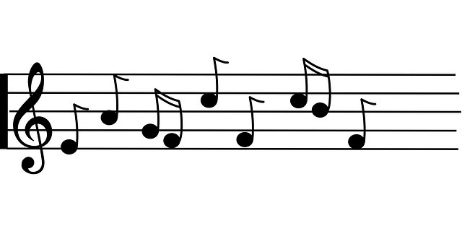
Art and Music
Other ways you can express yourself include;
Creating a music playlist,
Listening to relaxation playlists already made,
Share your music playlist with friends or family,
Making sculptures with Play Doh,
Painting,
Drawing,
Dancing to your favourite song!
You can get creative and express yourself through art and music.
Mindfulness colouring is a great way to help us to relax and express ourselves in a colourful and creative way.
Can you think of any other creative ways you can express yourself?

Slide 9

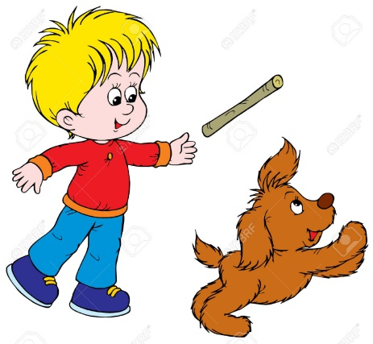
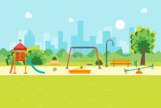
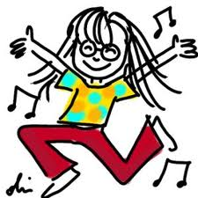
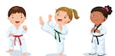
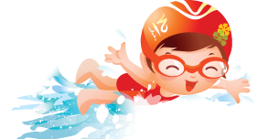
It’s really important that we look after our bodies, which is called our “physical health”. It’s also really important that we look after our minds too, which is known as our “mental health”.
Movement
Any activity where we are moving our bodies, usually makes us feel better.
Everybody is different and we all like doing different things.
Maybe your best friend likes ballet, while you prefer to ride your scooter.
What physical activities do you enjoy doing?

Slide 10
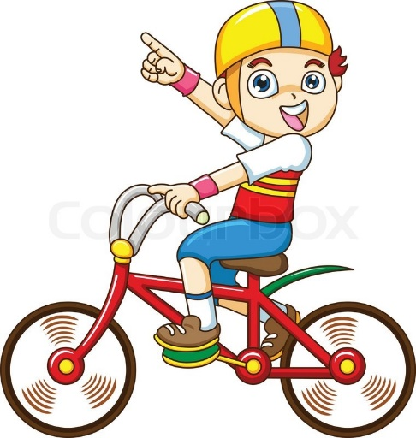
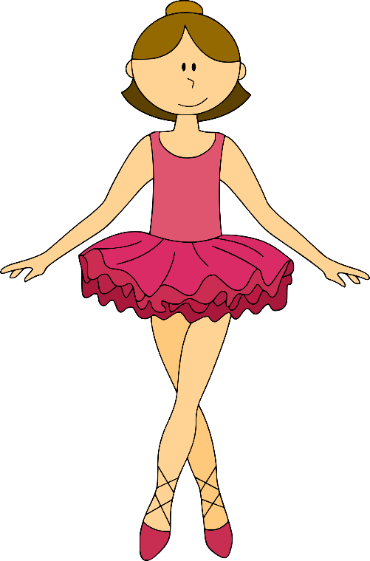
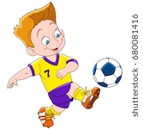
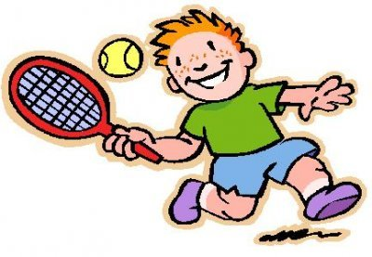
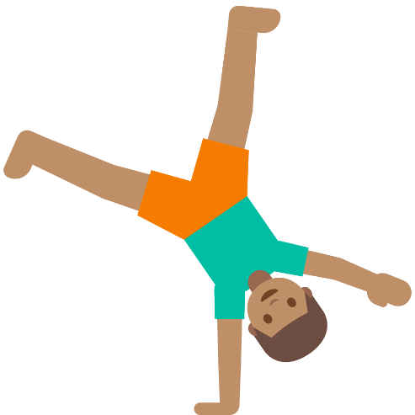
Feeling good can help our mental health especially when we might have difficult things to do or decide.
Movement
So, whether you’re playing football or dancing, it doesn’t matter if you’re the best or putting on a show for everyone else –
what really matters is that you enjoy doing it!
The most important thing about moving our bodies, is that it makes you feel good.
This Photo by Unknown Author is licensed under CC BY-NC

Slide 11
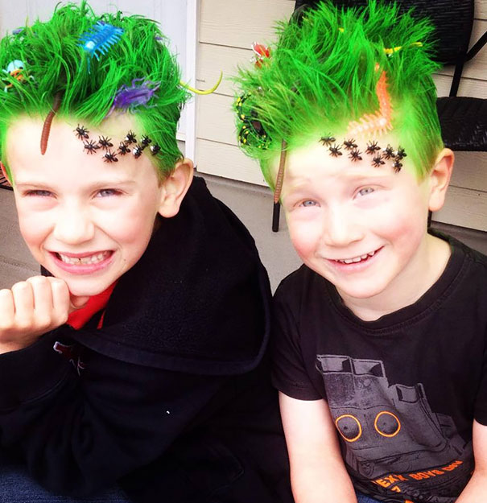

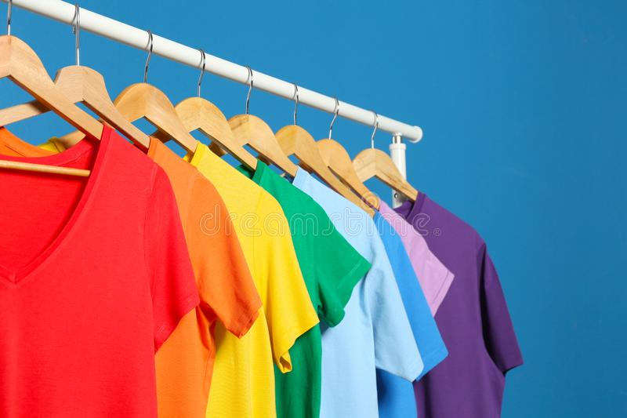
IMAGE!!
How can we express ourselves through the way we look?
Fashion
We can express how we are feeling or what we like through the way we dress. We can choose to wear something with our favourite tv show on it or something that we really love.
Hair and Make up
Sometimes we may want to show how we are feeling and our the way we style our hair, the way we do our make up, or even the colour we paint our nails! (for boys and girls!)
Did you know that wearing bright colours can help you feel happier?
So, why not join in with our Shine Bright, Wear Bright campaign and wear something bright and colourful to make you feel good and show support for CHUMS!?

Slide 12


Remember…
Recognise how you are feeling and remember it’s ok to feel different emotions.
Do what makes you feel great! Doing what we love can make us feel good.
Express yourself through art and music activities.
Our physical health and mental health are both very important.
Moving our bodies makes us feel better!
Everyone is different and that’s ok. Be you! Express yourself through your image!

Slide 13



Thank you!

