Slide 1
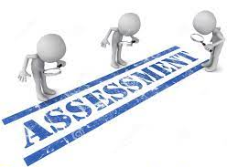

A look at Assessment at Marston Moreteyne School

Slide 2

Assessment in school is viewed as building a picture over time of a child’s learning progress across the curriculum and is posited as an integral part of teaching and learning.
Each classroom teacher is responsible for the ongoing assessment of his/her own pupils’ progress and achievement.
Teachers need to use a variety of assessment methods to support them in assessing pupils’ learning and in making decisions about their future learning.

Slide 3

There are two main types of assessment:
summative assessment and
formative assessment
These are sometimes referred to as
assessment of learning and
assessment for learning, respectively.
Both happen in all classrooms. The key to good assessment practice is to understand what each type contributes and to build your practice to maximise the effectiveness of each.

Slide 4


Summative assessment
Summative assessment sums up what a pupil has achieved at the end of a period of time, relative to the learning aims and the relevant national standards. The period of time may vary, depending on what the teacher wants to find out. There may be an assessment at the end of a topic, at the end of a term or half-term, at the end of a year or, as in the case of the National Curriculum tests, at the end of Key Stage Two (Year Six- which we currently do not have).
A summative assessment may be a written test, an observation, a conversation or a task. It may be recorded through writing, through photographs or other visual media, or through an audio recording. Whichever medium is used, the assessment will show what has been achieved. It will summarise attainment at a particular point in time and may provide individual and cohort data that will be useful for tracking progress and for informing stakeholders (e.g. parents, governors, etc.)

Slide 5


Formative assessment
Formative assessment takes place on a day-to-day basis during teaching and learning, allowing teachers and pupils to assess attainment and progress more frequently. It begins with diagnostic assessment, indicating what is already known and what gaps may exist in skills or knowledge.
If a teacher and pupil understand what has been achieved to date, it is easier to plan the next steps. As the learning continues, further formative assessments indicate whether teaching plans need to be amended to reinforce or extend learning.
Formative assessments may be questions, tasks, quizzes, observations and children’s ongoing work.
Often formative assessments may not be recorded at all, except perhaps in the lesson plans drawn up to address the next steps indicated.

Slide 6

There are a number of key paragraphs in the new School Inspection Handbook that relate to assessment. These are particularly significant.
Firstly, regarding the implementation of the curriculum:
“The most important factors in how, and how effectively, the curriculum is taught and assessed are that: teachers check pupils’ understanding effectively, and identify and correct misunderstandings… teachers use assessment to check pupils’ understanding in order to inform teaching.”
In relation to the school’s use of assessment, the handbook states:
“When used effectively, assessment helps pupils to embed knowledge and use it fluently, and assists teachers in producing clear next steps for pupils.”
Looking at these points, we can see a clear emphasis on what is going on in the classroom. So we need to ask ourselves the questions, how well are teachers are using formative assessment techniques to:

Slide 7


find out what children already know so that they can build on this
Unpick children’s misconceptions
check learning within (as well as at the end of) lesson
provide effective feedback to move learning forwards
In addition to these points about classroom assessment, the handbook says that inspectors will use to gain evidence about curriculum implementation “discussions with curriculum and subject leaders and teachers about… their view of how those pupils are progressing through the curriculum”

Slide 8

A look at Statutory Assessment
The government continues to measure and compare the outcomes of children nationally; in their Reception year, Year One, Year Two, Year Four

Slide 9


Reception- Acorn Classes
Reception Baseline Assessment (RBA)
The RBA is an age-appropriate assessment of early mathematics and literacy,
communication and language.
It is administered within the first six weeks of a pupil starting reception.
The assessment has two components,
each consisting of practical tasks using physical resources.
There is an online scoring system for the practitioner to use as the pupil engages with the tasks.
The RBA will be used to create school-level progress measures for primary schools which will show the progress pupils make from reception until the end of Key Stage 2
Narrative statements on how pupils performed in the assessment, across both components.
No numerical score will be shared and assessment data will only be used to calculate the progress measure.

Slide 10
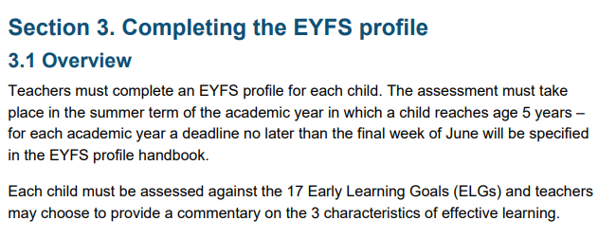
Reception- Acorn Classes
EYFS Profile
At the End of the year, teachers assess each child as-
meeting ‘expected’ levels or
not yet reaching expected levels
The “exceeding” band had been removed

Slide 11
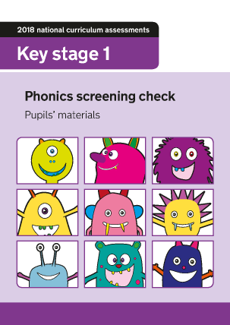

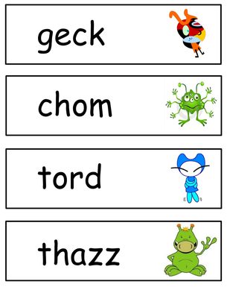
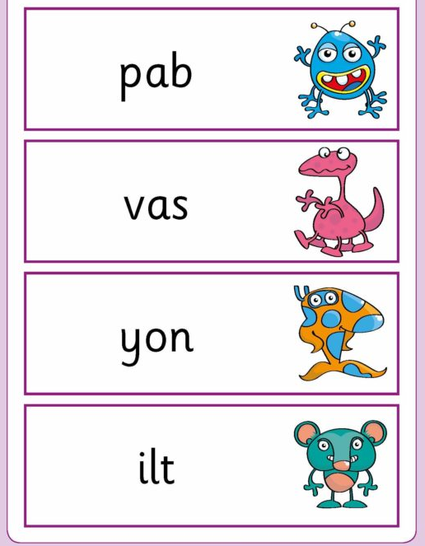
Year One- Beech Classes
Year 1 Phonics Screening Check
The purpose of the phonics screening check will be to confirm that all children have
learned phonic decoding to an age-appropriate standard.
40 words, pass mark 32 (subject to change!)

Slide 12
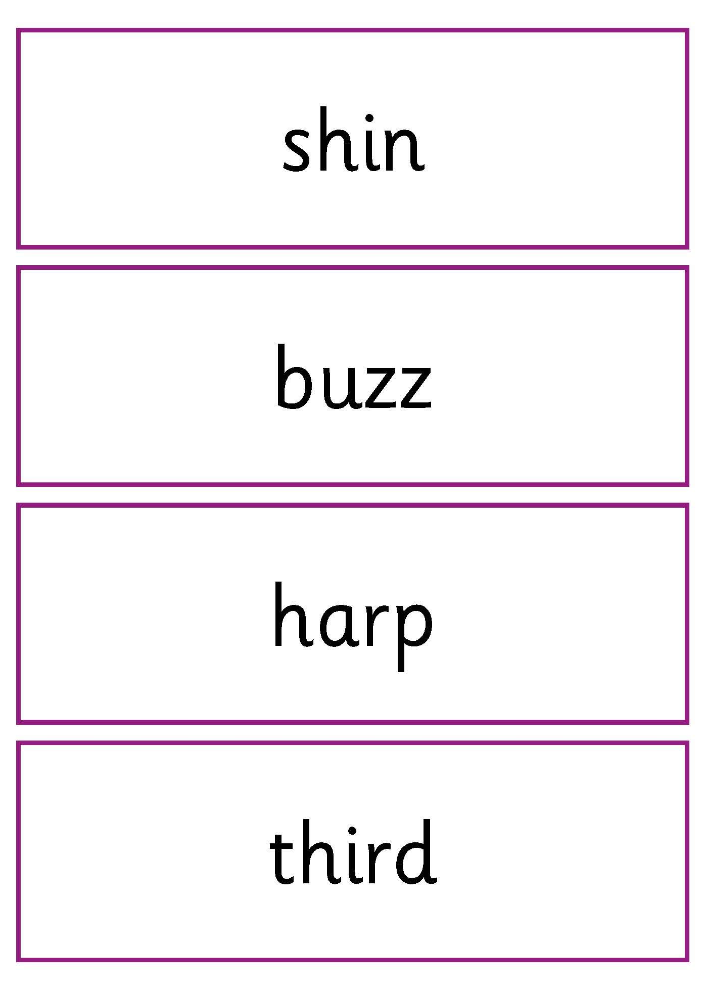
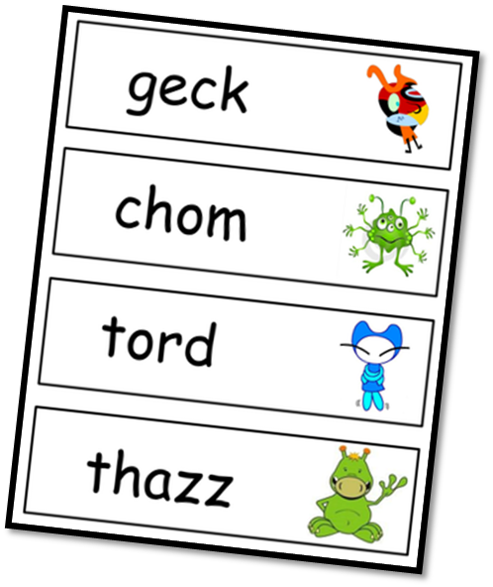
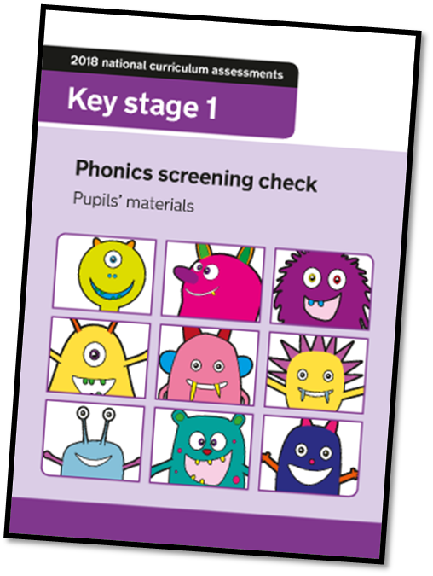
Year Two- Sycamore Classes
Phonics Screening Check- RE-SITS
(for children who did not meet the standard in Y2)

Slide 13
Pre-key stage standards
Pre-key stage standards must be used for statutory assessment of pupils at the end of
KS1 who are working below the overall standard of national curriculum assessments and
engaged in subject-specific study, as well as for pupils who are working below the
standard of the national curriculum assessments because they:
• have not completed the KS1 programmes of study but are still moving onto KS2
with their current year group (and are engaged in subject-specific study)
• cannot communicate in English (and are engaged in subject-specific study)
The pre-key stage standards follow the same principles as the TA frameworks. They
each contain ‘pupil can’ statements for teachers to assess against, providing evidence to
show that pupils have met the standard they have been awarded.
Teachers should follow the specific guidance for each subject when making their judgements.
The pre-key stage 1 standards for English reading, English writing and mathematics are:
• Standard 4
• Standard 3
• Standard 2
• Standard 1

Slide 14

Year Four- Oak Classes
The Multiplication Times Tables
Check (MTC)
The Multiplication Tables Check (MTC) was officially announced by the Department for Education (DfE) in September 2017.
It will be administered for children in Year Four
rolling out from the summer term 2022 from
Monday 6th June 2022.
The purpose of the MTC is to determine whether Y4 pupils can recall their multiplication tables fluently (being able to answer times tables questions accurately and quickly, without having to work out the answers).
Children will have 6 seconds to answer each question in a series of 25. Each question will be worth one mark and be presented to the child in this format:
n1 x n2 = ____
Questions will be selected from the 121 number facts that make up the multiplication tables from 2 to 12, with a particular focus on the 6, 7, 8, 9 and 12 times tables as they are considered to be the most challenging. 4 x 3)
Results and reporting
At the end of the assessment window, a total score out of 25 will be reported to each
school for all of their pupils who took the check.
There will be no expected standard threshold for the MTC.

Slide 15
A look at
Non- Statutory Assessment

Slide 16



This guidance sets out the pathways of children’s development in broad ages and stages.
It helps to make informed decisions about what a child needs to learn and be able to do
next.
The new Development Matters has ‘checkpoints’ for children in the Prime areas of Communication and Language, Personal, Social and Emotional Development, and Physical Development. They help staff to see if children are
“On Track” or “Not on Track” through the year.

Slide 17
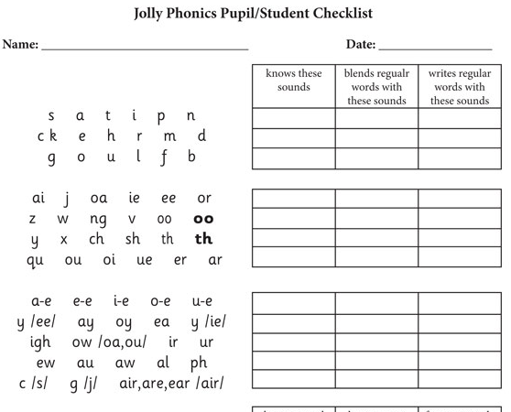

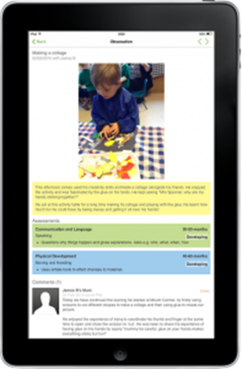
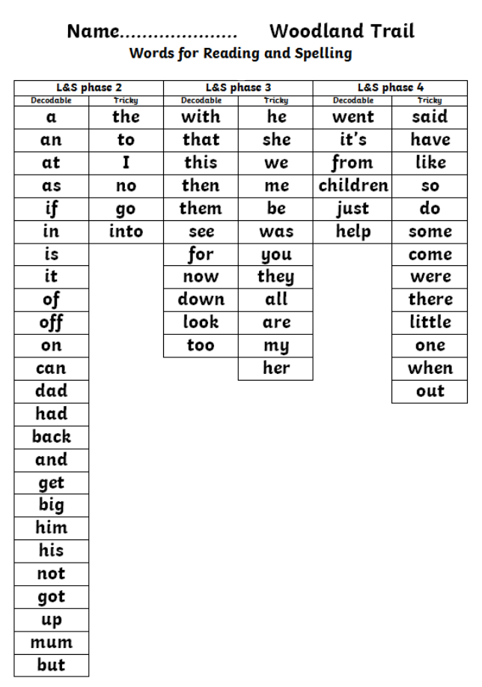

At regular point in the year Early Years Practitioners carry out:
own “in house” Baseline Assessment in order to evidence progress. This is then re-visited through the year (English and Maths)
phonic assessment as new content introduced (including blending and segmenting skills)
tricky word assessment taken from the “Woodland Trail” (and beyond…!)
Assessed pieces of un-aided writing.
Ongoing observations of learning within continuous provision-”wow” moments recoded on Tapestry to add evidence to their EYFSP
Reading book stages tracked through the year.
SEND plans
Reports to parents with targets

Slide 18
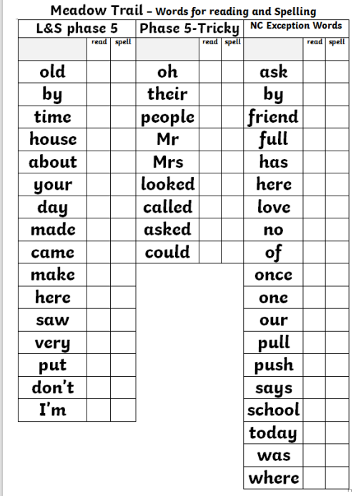
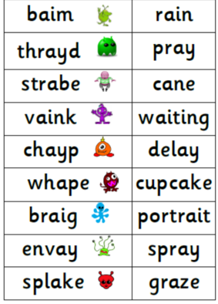
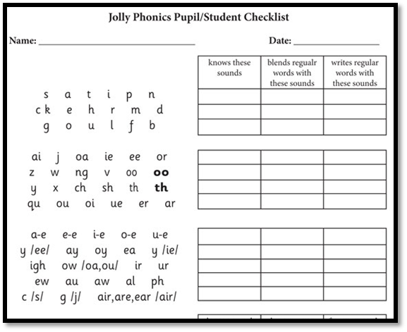
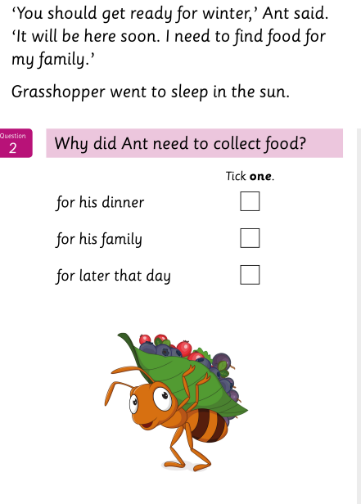
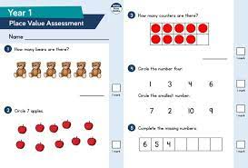
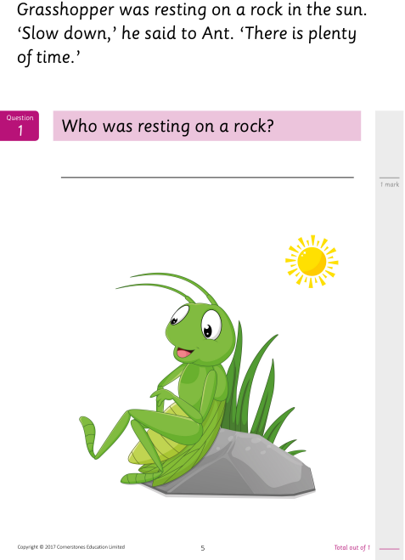

Year One- Beech Classes
phonic assessment- Entry then half termly
high frequency words from the “Meadow Trail”- Reading and Spelling
(or other Trails as appropriate)
practise Phonic Screening Checks
reading stages monitored (monthly)
Cornerstone reading assessments
(Spring and Summer Terms Only)
White Rose Maths end of unit assessments
half termly independent writing tasks
weekly “quizzes”-other curriculum areas, curriculum areas based on KOs
Termly foundation subject summative judgments
SEND plans
reports to parents with targets
Daily Formative Assessment happens as part of the teaching process.

Slide 19

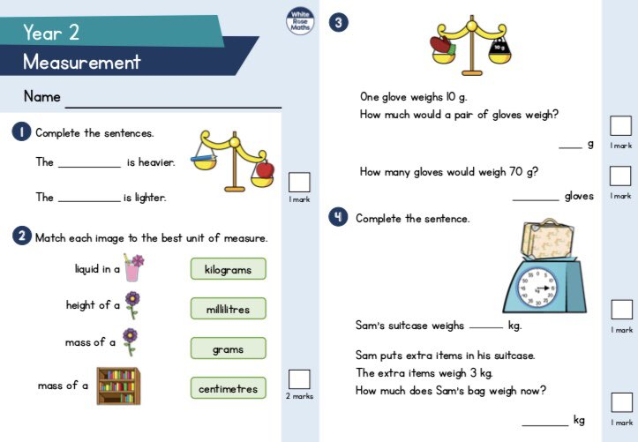
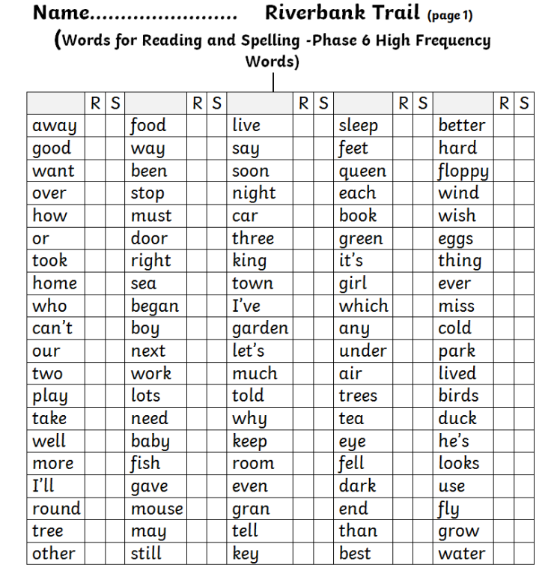
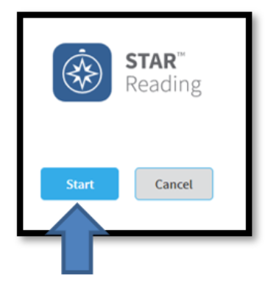
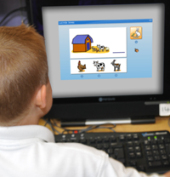
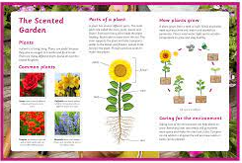
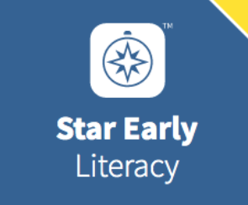
Year Two- Sycamore Classes
phonic assessment- entry then half termly (up to Phase 6)
high frequency words from the “Riverbank Trail”- Reading and Spelling (or other Trails as appropriate)
practise Phonic Screening Checks (for Y2s who DNRS)
reading stages monitored monthly
White Rose Maths end of unit assessments
STAR tests by Renaissance (or SELT)- from Spring Term
half termly independent writing tasks
weekly “quizzes”- curriculum areas based on KOs
termly foundation subject summative judgments
SEND plans
reports to parents with targets
Daily Formative Assessment happens as part of the teaching process.

Slide 20
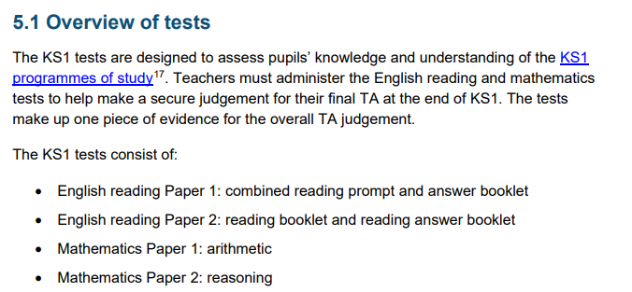
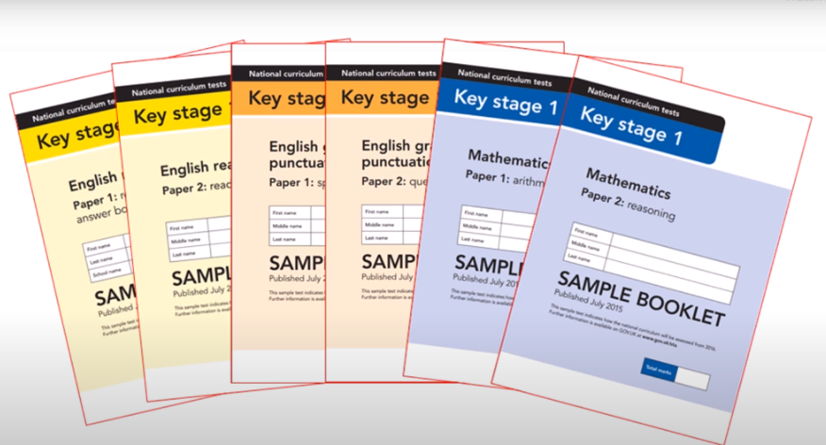
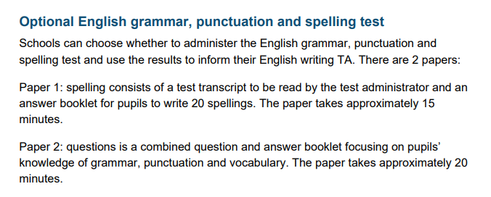
Year Two- Sycamore Classes
Key Stage One
SATs (Standard Assessment Tests)
These were previously Statutory but they were made non-stat in 2023. As a school we still administer these to inform our own assessment.

Slide 21
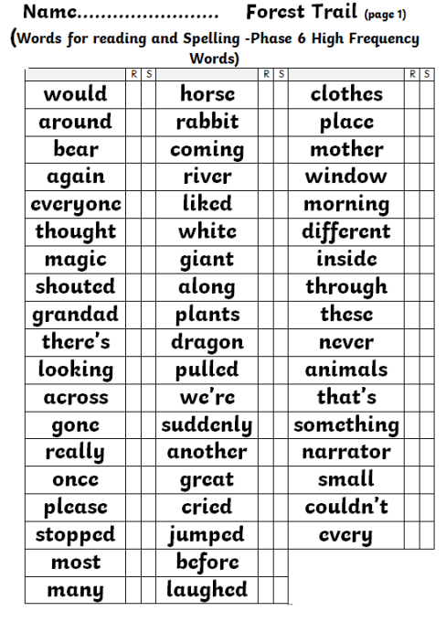

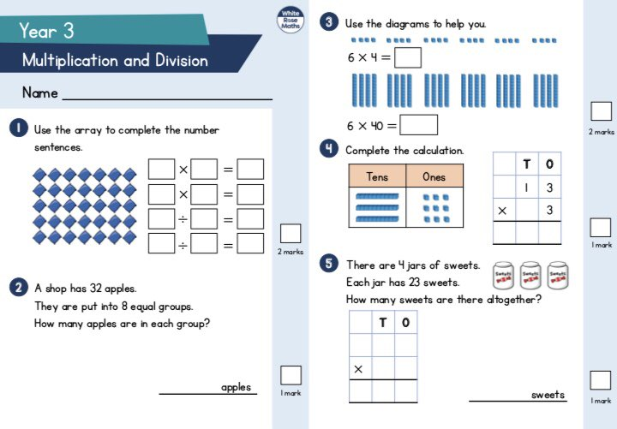
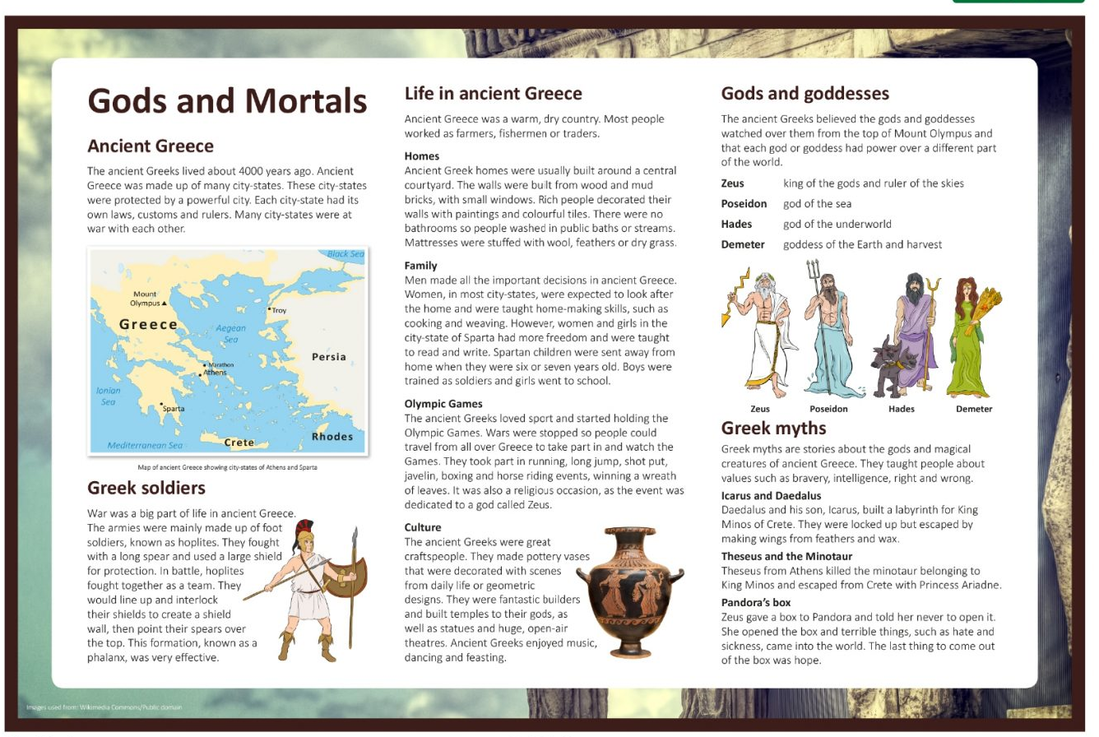
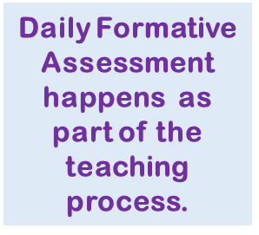
Year Three- Willow Classes
phonic assessment- entry then half termly (up to phase 6)
high frequency words from the “Forest Trail”- Reading and Spelling (or other Trails as appropriate)
reading stages monitored monthly
White Rose Maths end of unit assessments
STAR tests by Renaissance (or SELT)- from Autumn Term
half termly independent writing tasks
weekly “quizzes” on curriculum areas based on KO’s
termly foundation subject summative judgments
SEND plans
reports to parents with targets

Slide 22
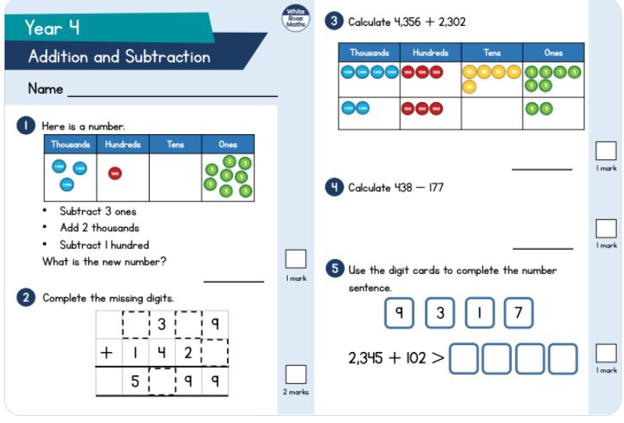
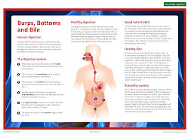
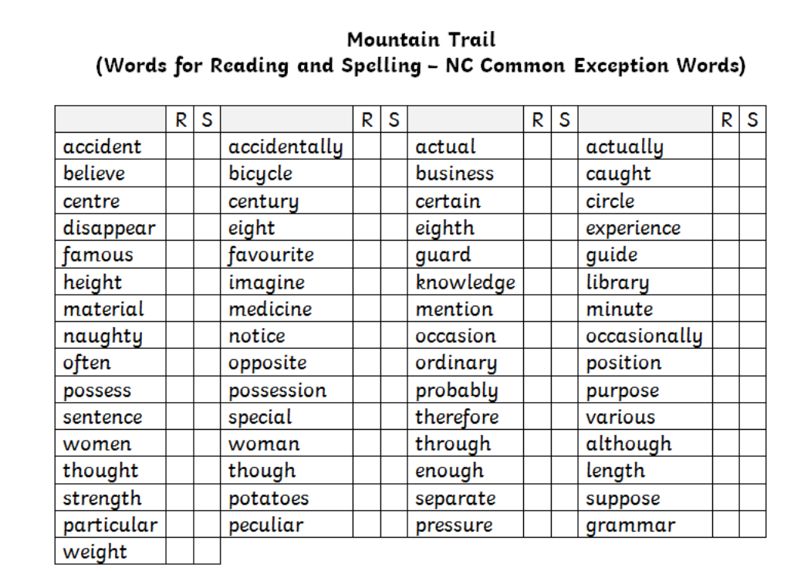
Year Four- Oak Classes
phonic assessment- entry then half termly (up to phase 6)
high frequency words from the “Forest Trail”- Reading and Spelling (or other Trails as appropriate)
reading stages monitored monthly
White Rose Maths end of unit assessments
STAR tests by Renaissance (or SELT)- from Autumn Term
half termly independent writing tasks
weekly “quizzes”- curriculum areas -based on KOs
termly foundation subject summative judgments
SEND plans
reports to parents with targets
Daily Formative Assessment happens as part of the teaching process.

