Slide 1

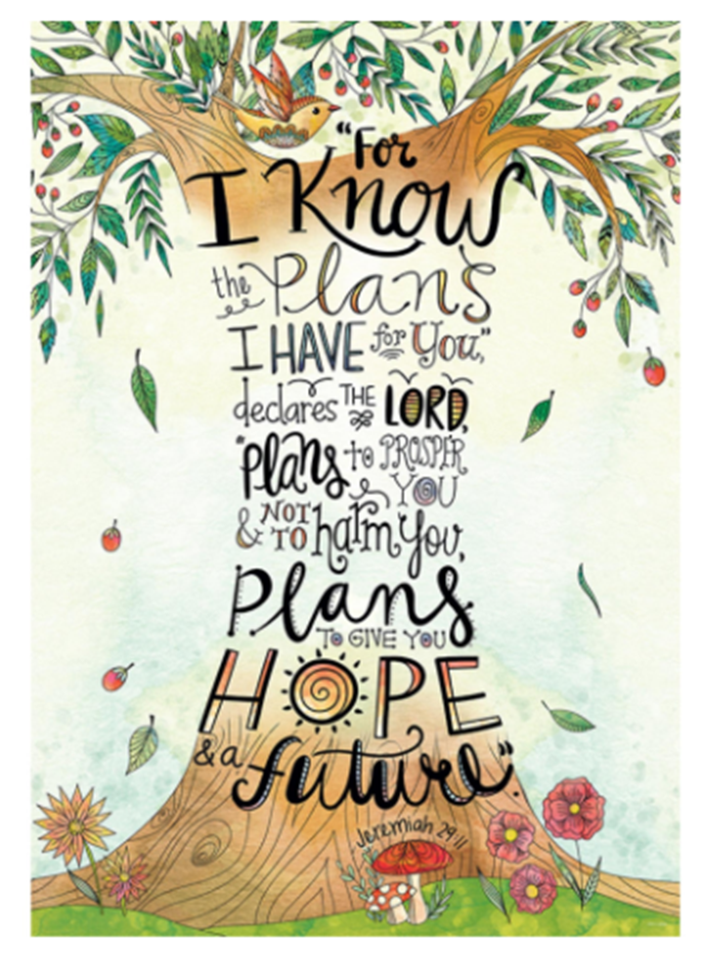
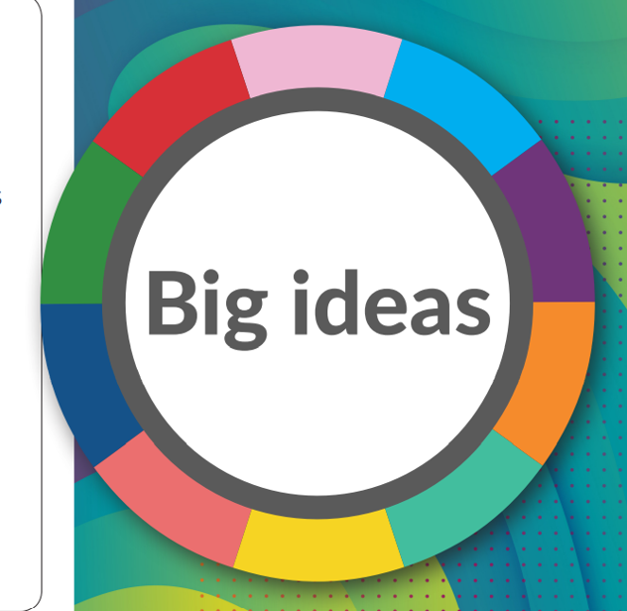

Slide 2
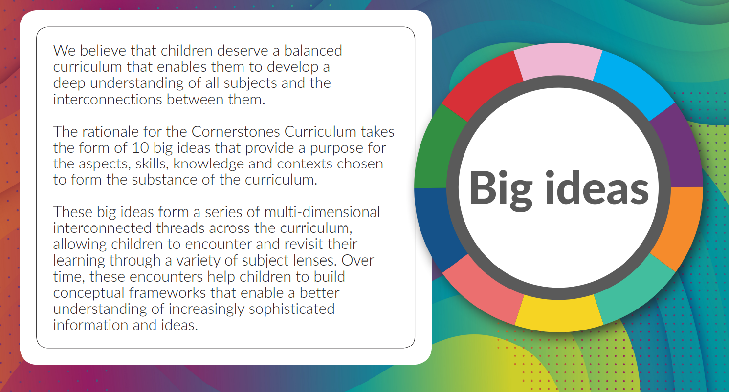

Slide 3
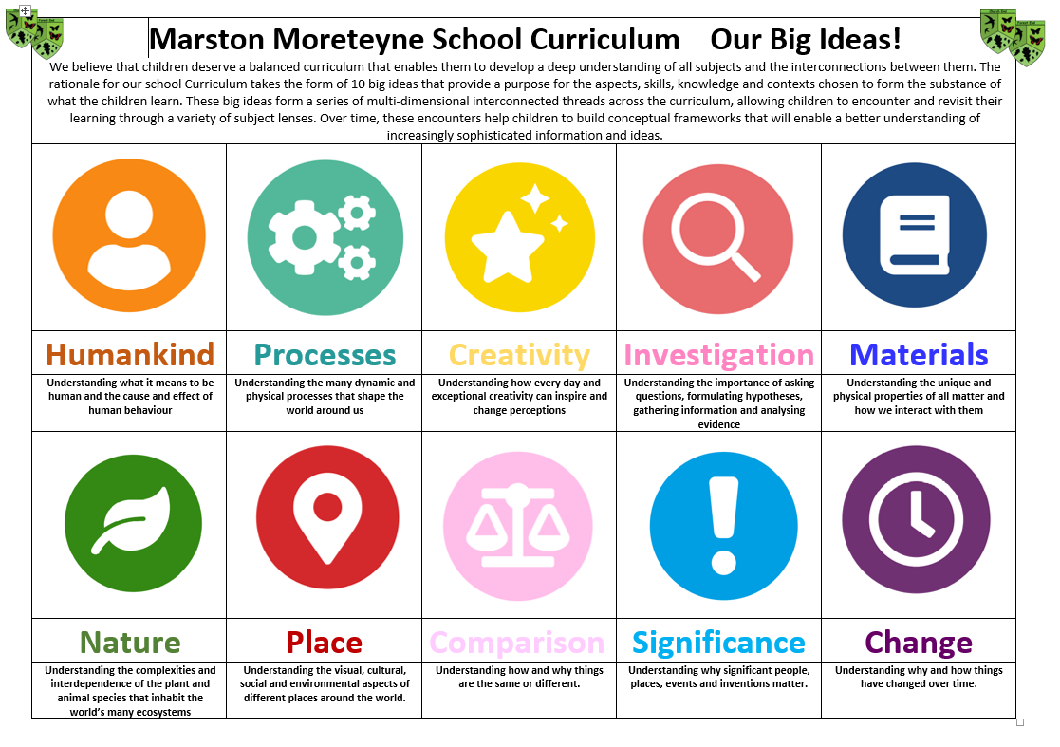

Slide 4
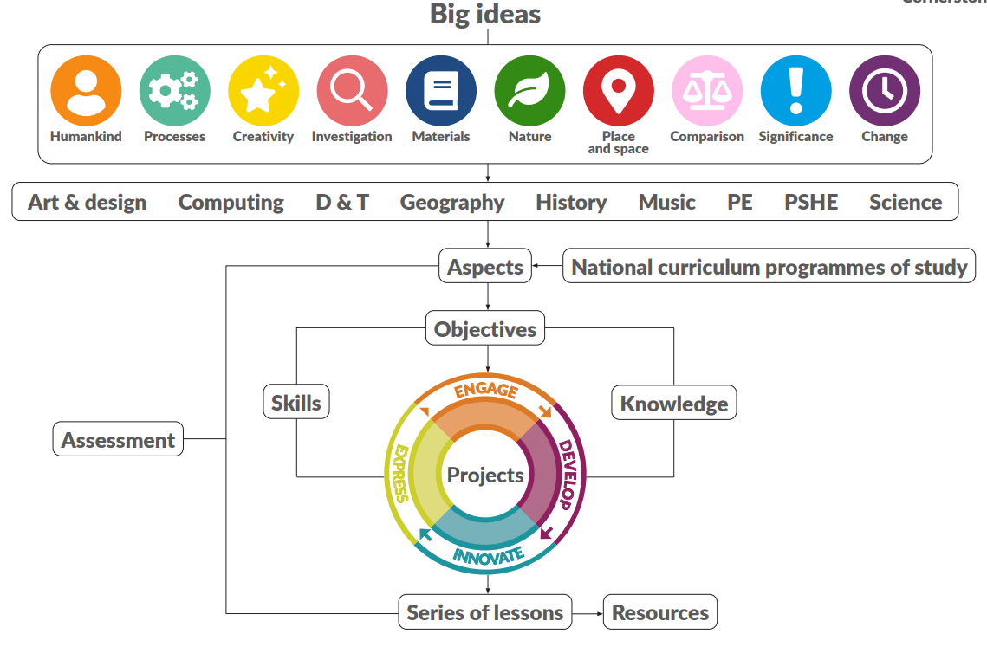

Slide 5
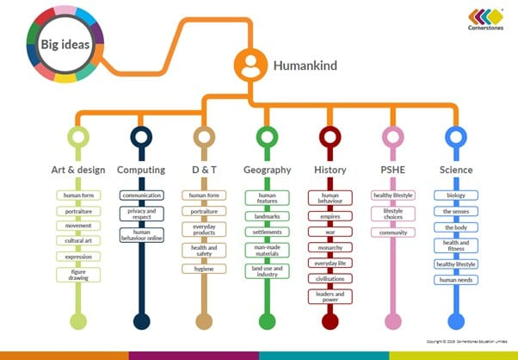
Throughout the Cornerstones curriculum, larger concepts are woven. These big ideas are designed to help children develop a wider and more general understanding of the world.
For example, One ‘big idea’ is ‘Humankind’. See below how this big idea is woven throughout subjects and also revisited and developed upon in different year groups

Slide 6
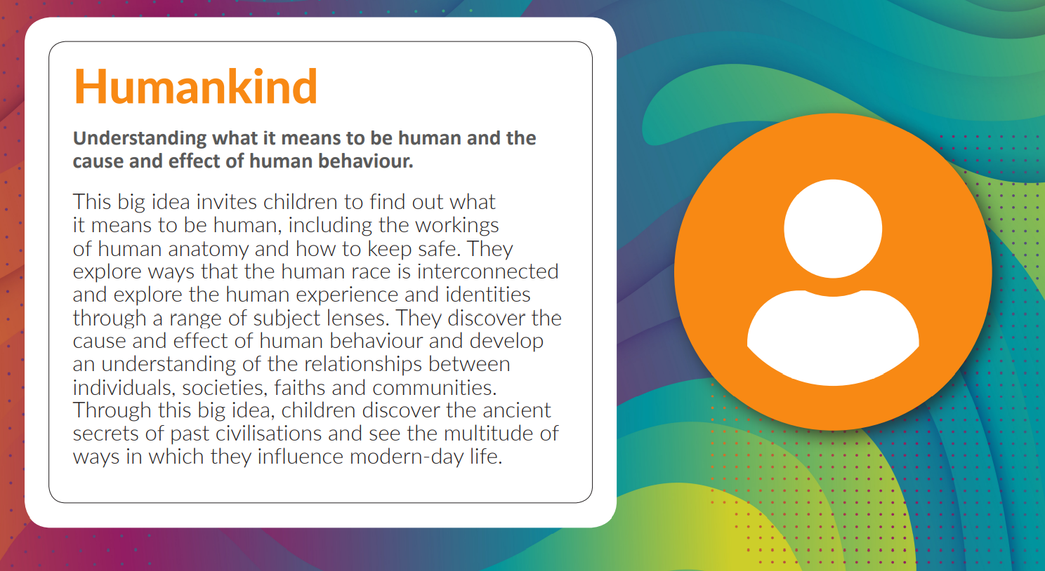

Slide 7
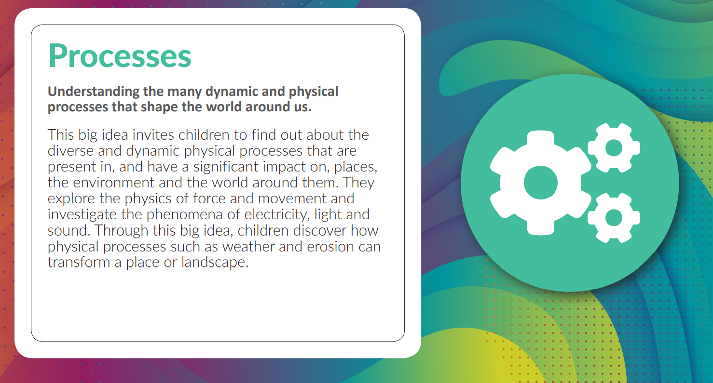

Slide 8
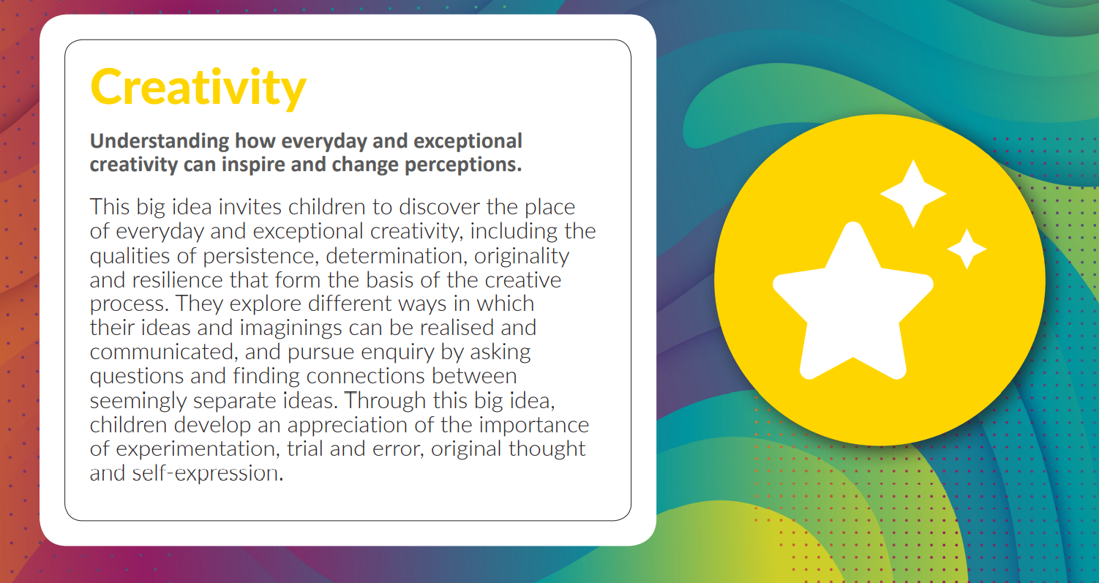

Slide 9
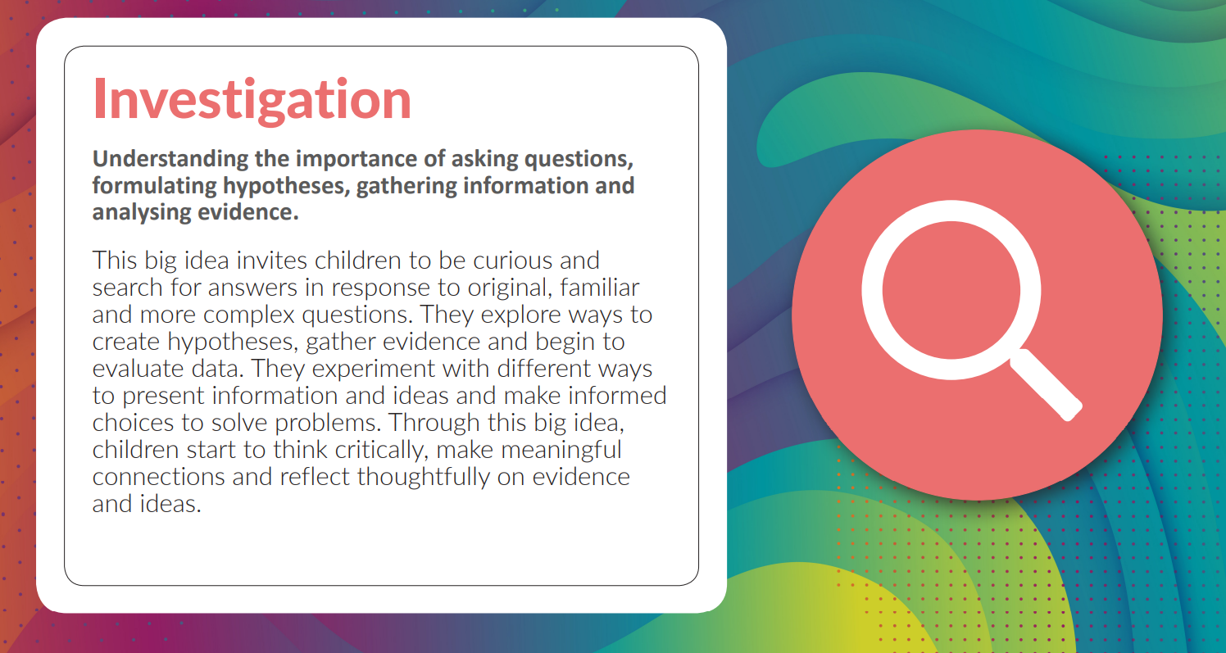

Slide 10
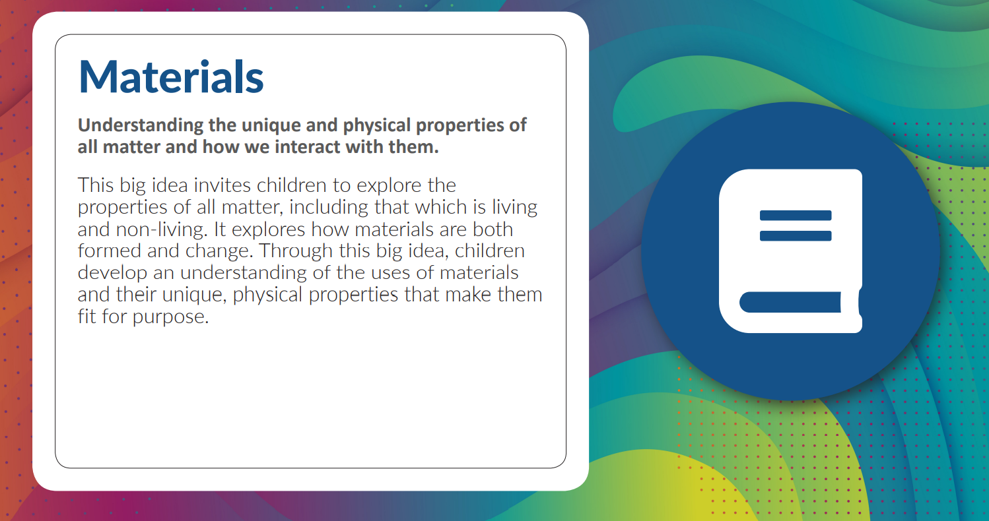

Slide 11
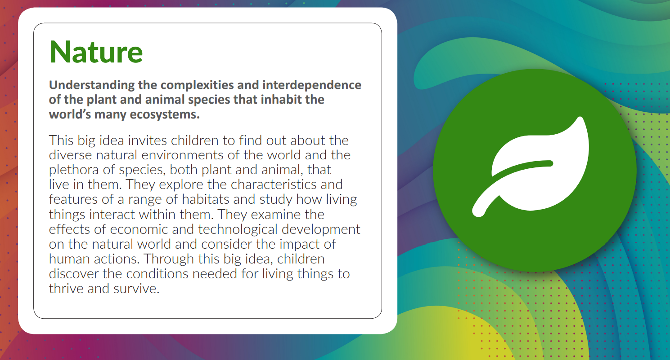

Slide 12
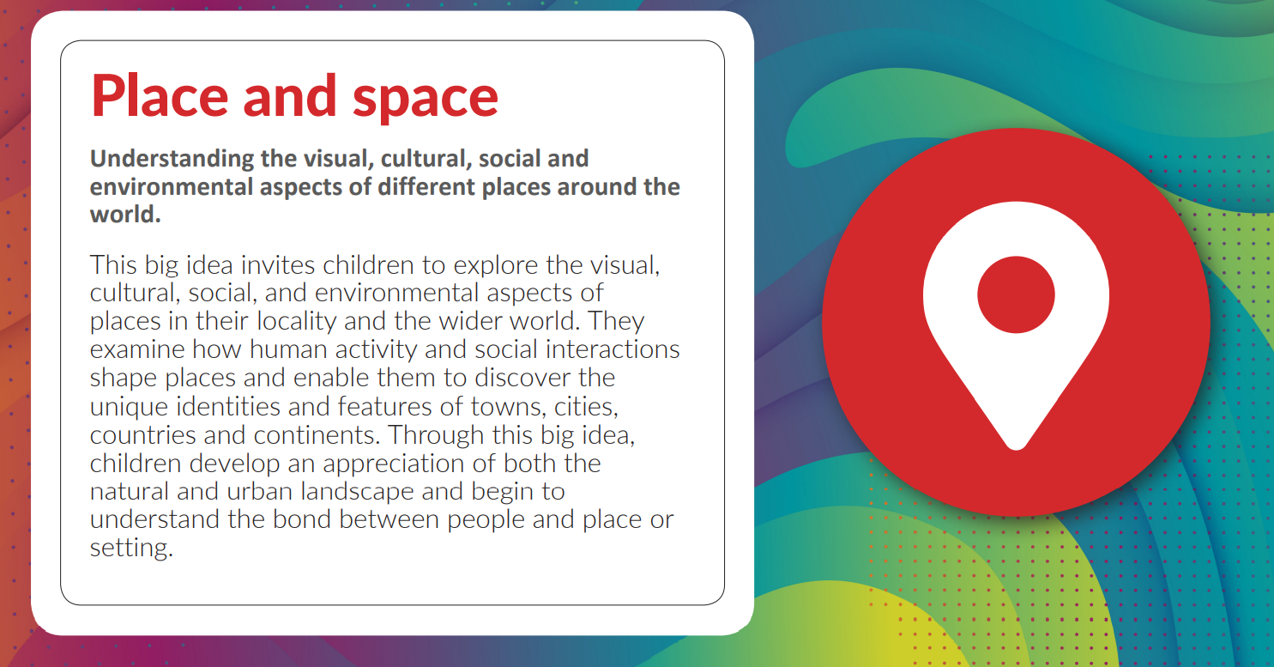

Slide 13
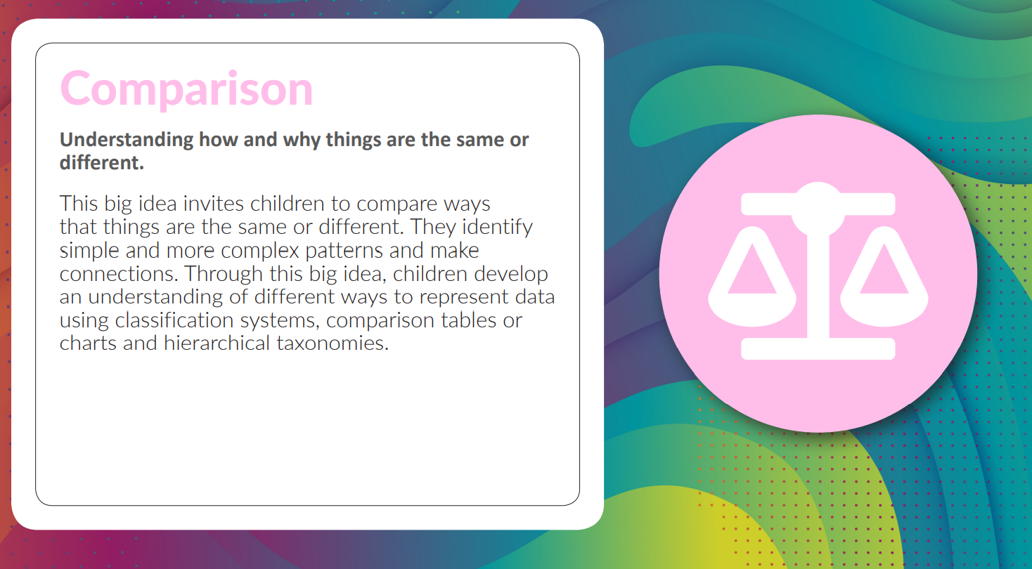

Slide 14
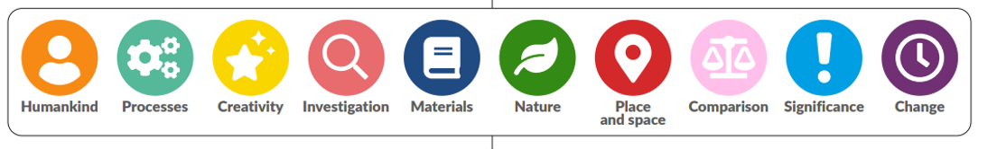
Each curriculum subject is broken down into “Aspects” developed from the “Big Ideas”
The “Aspects” below are progressive and start from Nursery through to Year Four. They allow children to encounter and revisit their learning through a variety of subject lenses. Over time, these encounters help children to build conceptual frameworks that enable a better understanding of increasingly complexity.

Slide 15
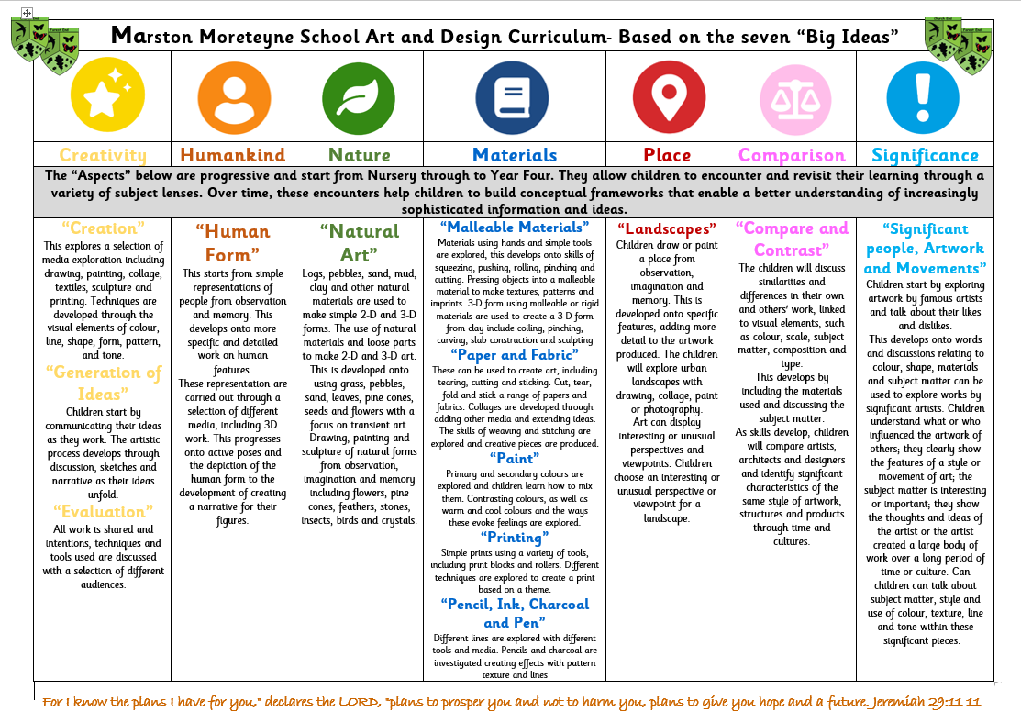
An example of a subject (Art and Design) Curriculum Intent. Based on the Big Ideas.

Slide 16


